Slide 1


Trainer of Trainers (ToT’s) Training
eSubsidy Livestock Vaccination Program

Slide 2
Overview
How to login on web / p3
How to reset your password / p4-p6
Selecting Roles / pg 7
Manage users / p8-p10
Manage users-Assign roles / p11-p13
Manage service points types / p14-p17
Manage service points types Assigning AHS to service point./ p18-p19
Receive stock / p20-p21
View Stock /p22
Redeem Voucher /p23-p27
Report Viewable /p28-p29
Sms logs /p30
Check Voucher Payments /pg 31
Support Contacts /pg 32

Slide 3
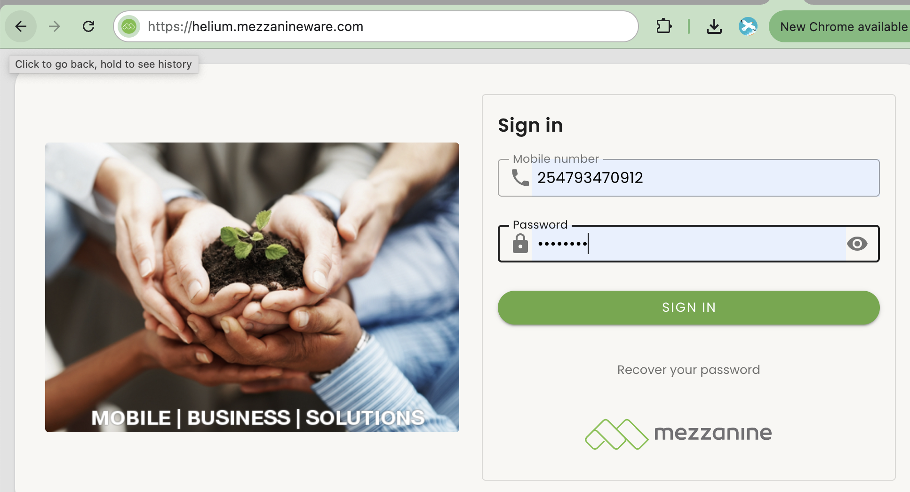
How to login on web
01
On your browser type Our web address then press enter:
https://helium.mezzanineware.com
Sign In:
  Username- It is the mobile number that you have been registered with. Remember to use your country code when entering your mobile number, e.g. 254XXXXXXXXX.
  Password- Use the “one time password” you received from the mobile number that you have been registered with, as well as the password. Remember to use your country code when entering your mobile number.
(3) Click the ”Sign in” button.
02
03

Slide 4
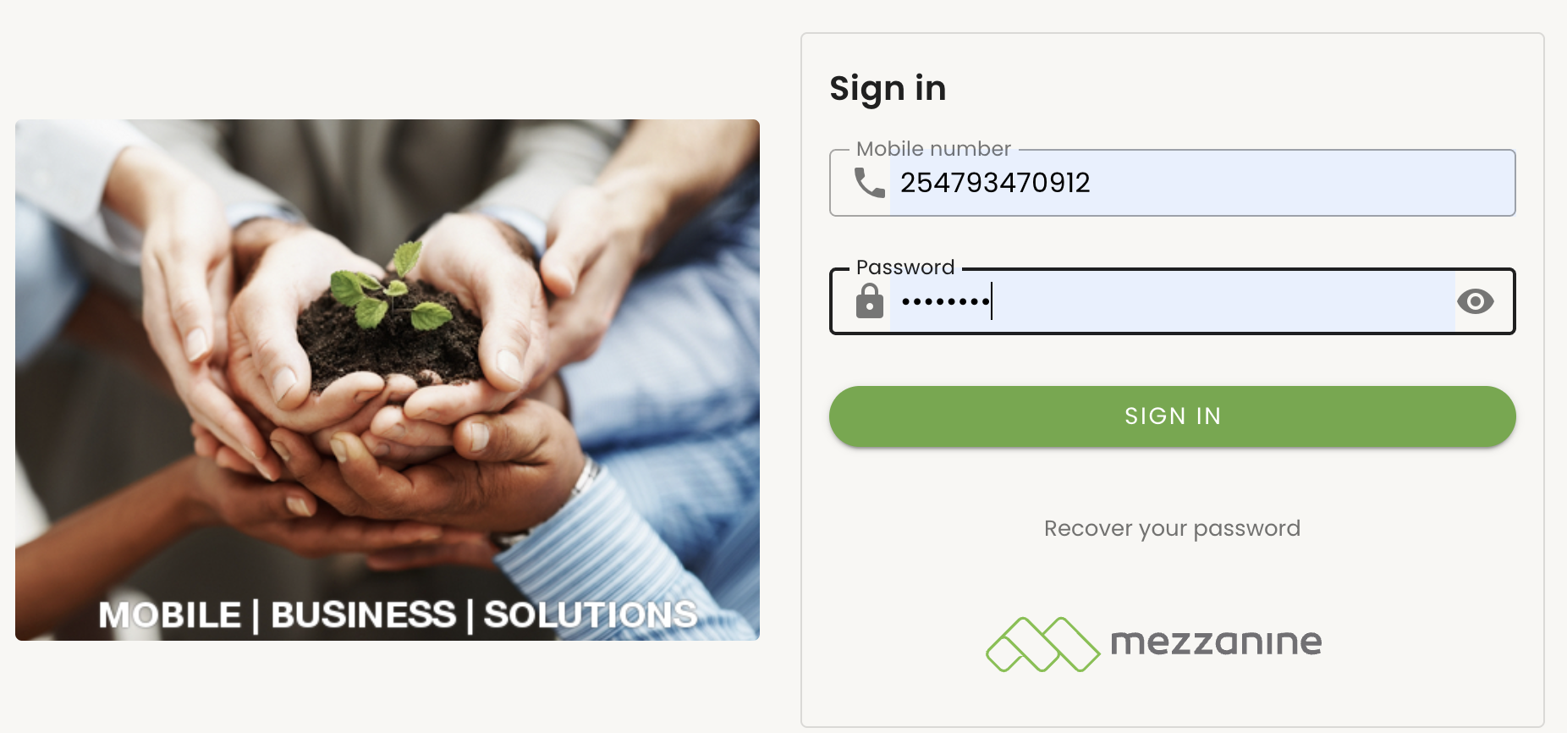
How to reset your password
If you have forgotten your password and you want to recover it, click on the “Recover your password” link.

Slide 5
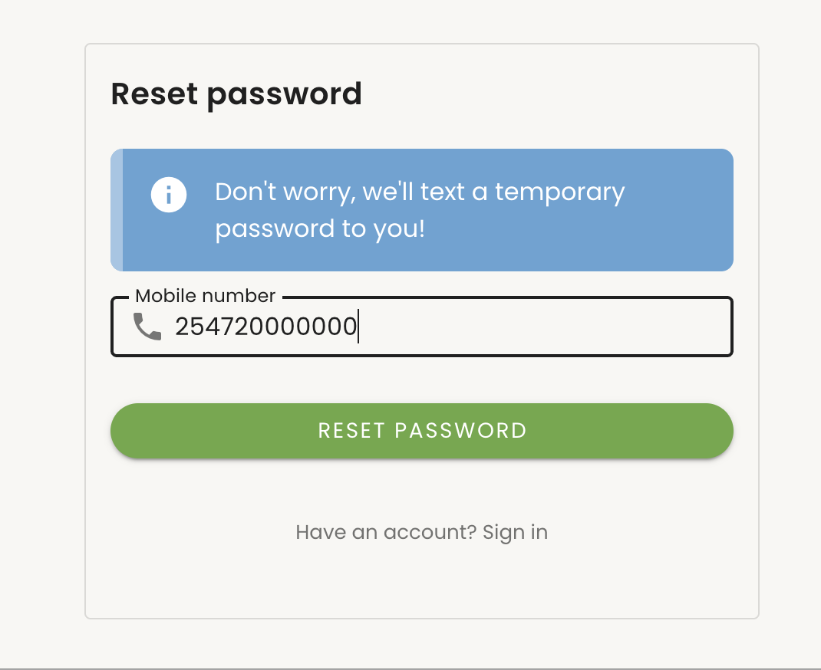
How to reset your password
You will be redirected to this page, where you must input the mobile number of the user starting with the country code i.e. “254XXXXXXXXX” for Kenya.
Click on the “Reset Password” button.
After a minute, check your phone for the SMS that will contain your new password.

Slide 6
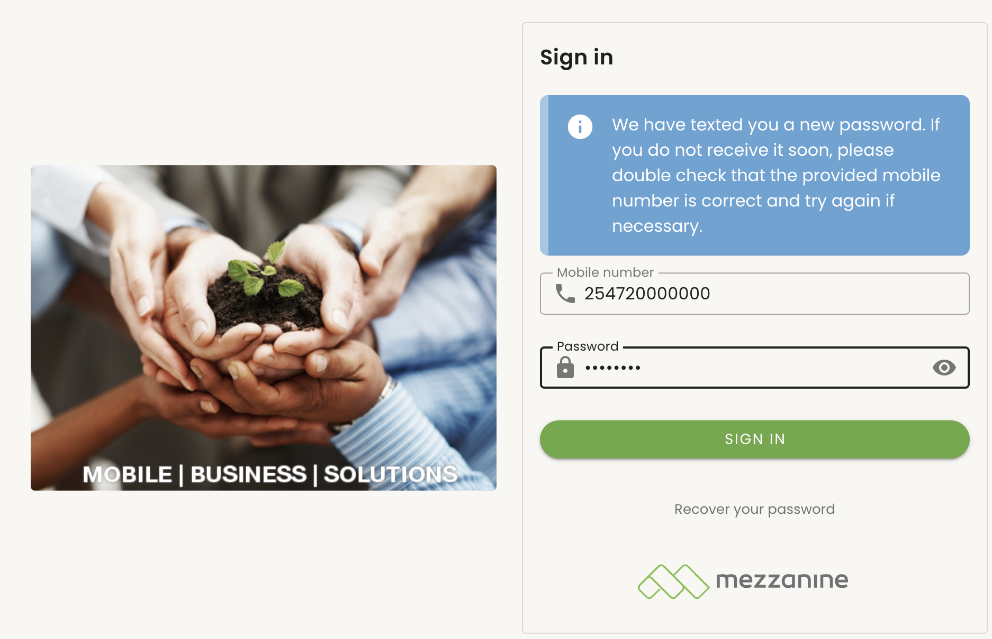
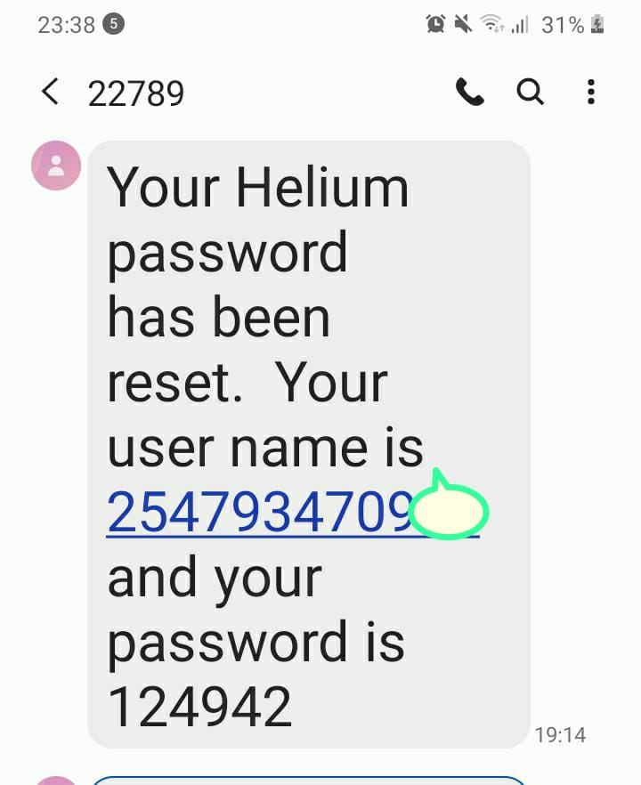
How to reset your password
The message will contain your username and password which you will then use to login.
You will be redirected to the Mid-P Merit web once you have successfully logged in.
SMS from your phone

Slide 7
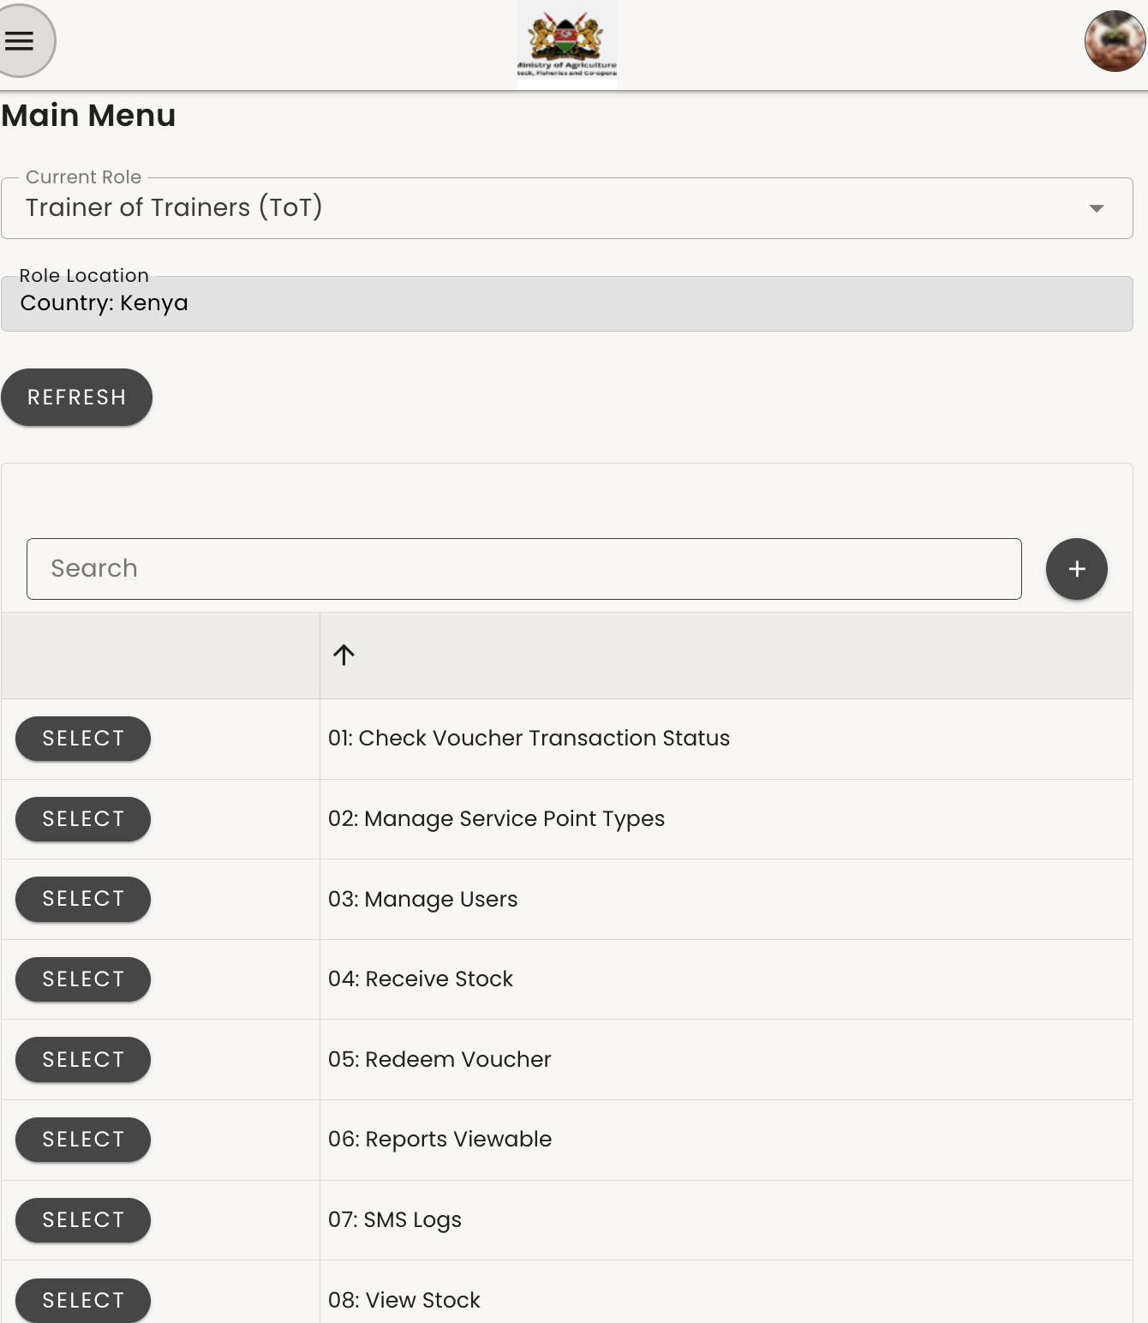
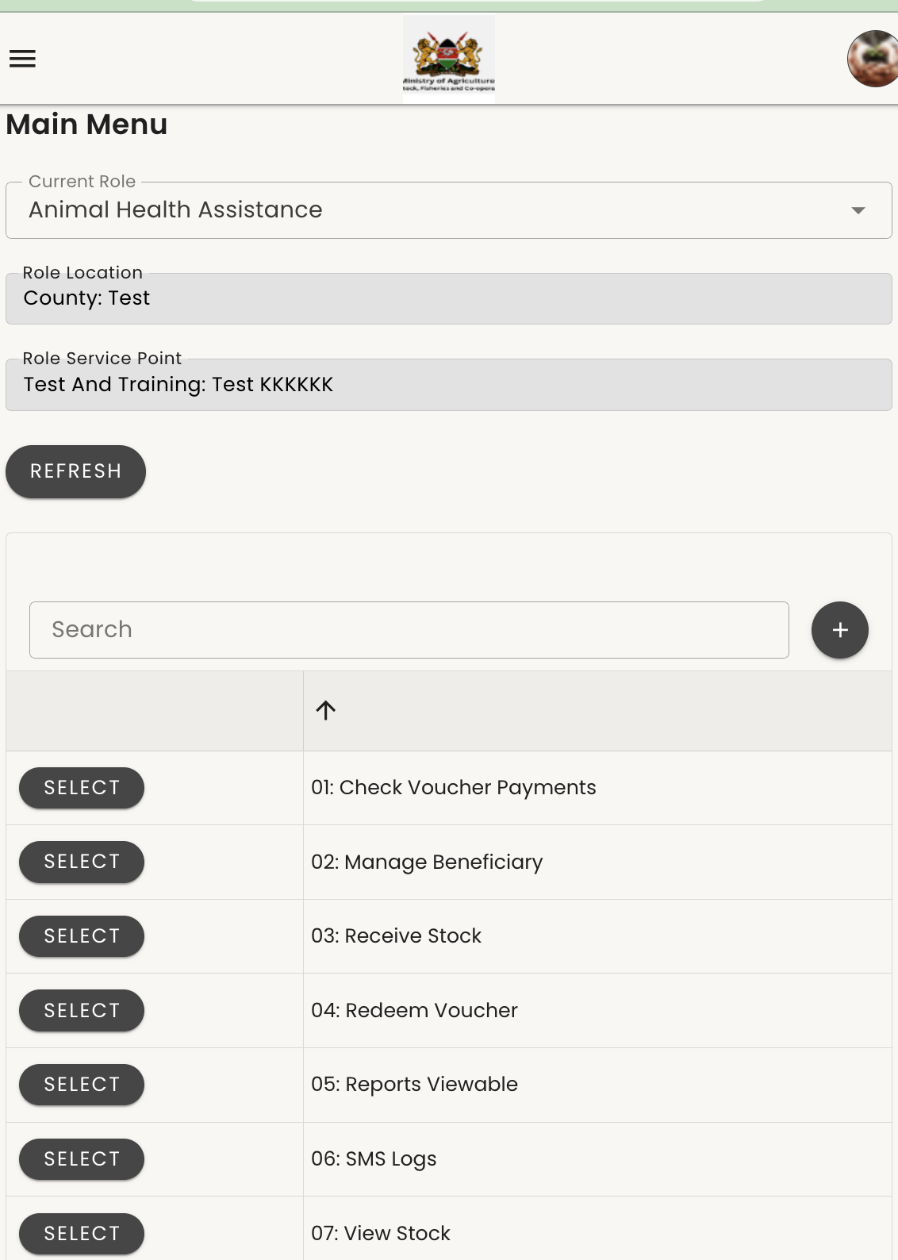
Selecting roles
Landing Page After Signing In
After signing in, the landing page displayed will depend on your assigned role.
If you have more than one role, click the drop-down menu to select the desired role. You can also click Refresh to update the actions linked to the selected role.

Slide 8
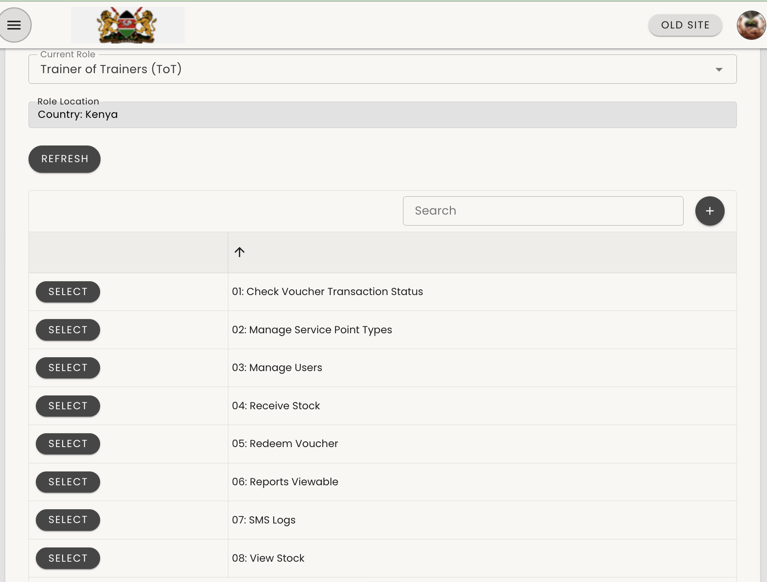
Manage Users
1.On the Main Menu, click the dropdown field next to "Current Role."
2.From the list of options that appears, select "Trainers of Trainers (ToT)."
3.After selecting the role, click the "Refresh" button to load the relevant menu options.
4.Once refreshed, go to the Main Menu and select "Manage users."

Slide 9
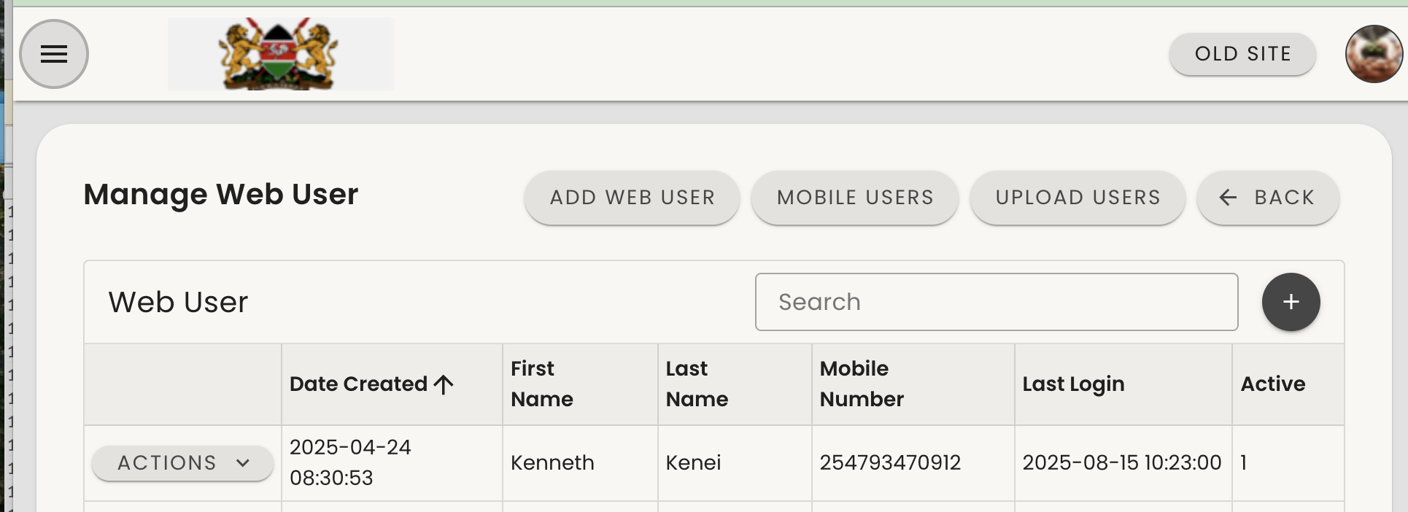
Manage Users
This is the page that appears after selecting “Manage Users.” To add a new user, click the “Add Web User” button located at the top right corner.
Note: The Vaccination instance does not have a mobile application. Therefore, all users —including Animal Health Assistants, Veterinarians, Trainers of Trainers (TOTs), and others — must be added as Web Users rather than Mobile Users.

Slide 10
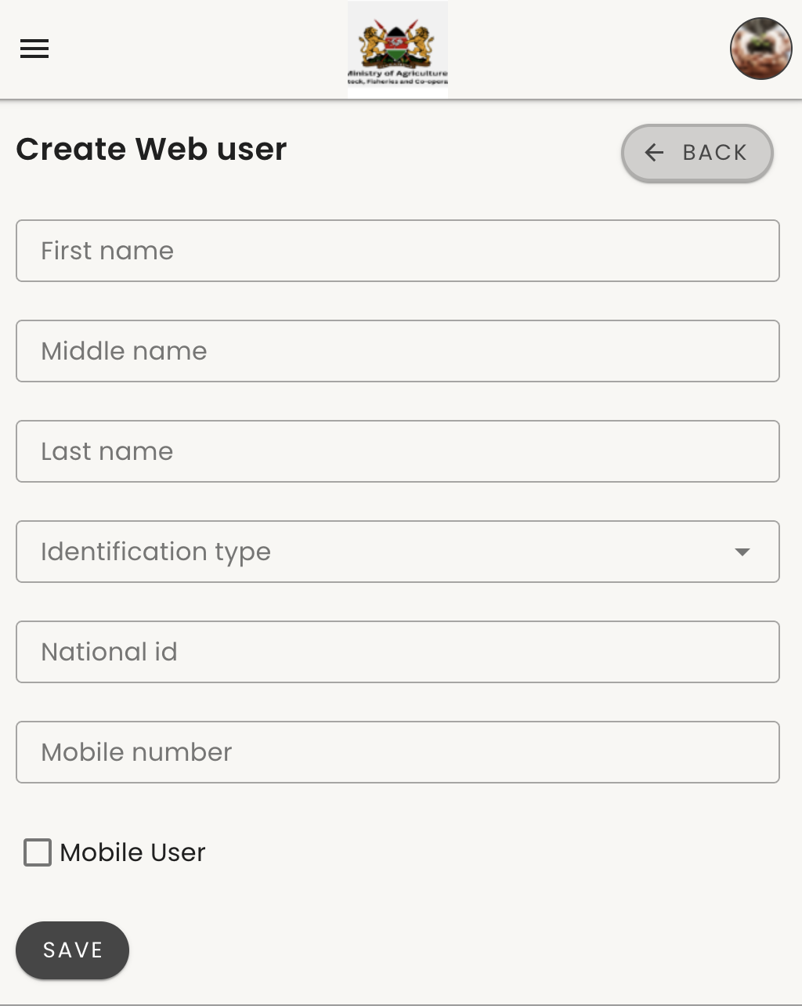
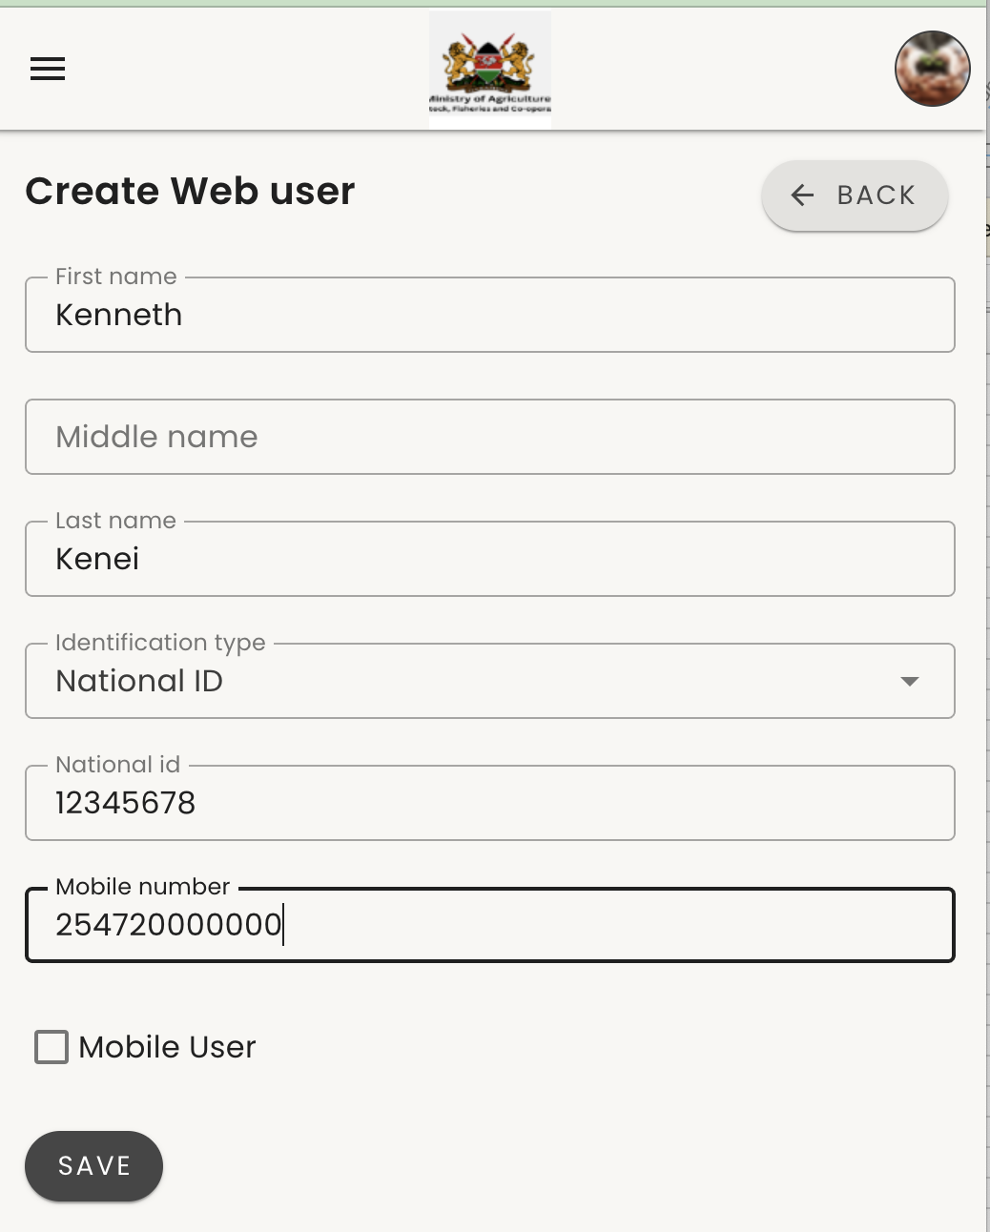
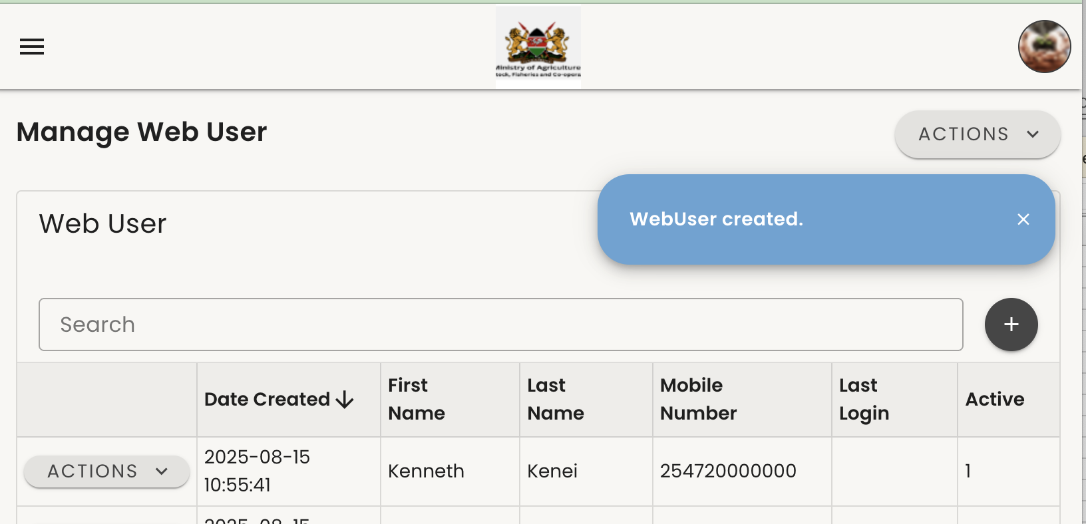
Manage Users
After clicking “Add Web User,” you will be taken to this form.
Navigate through the form and fill in the user's details i,e user names,Id number mobile number etc.
Important:
  Do NOT check the “Mobile User” checkbox, as mobile App Is not supported in this instance.
After clicking "Save," the user is successfully created, and a blue pop-up notification appears confirming that the user has been created.

Slide 11
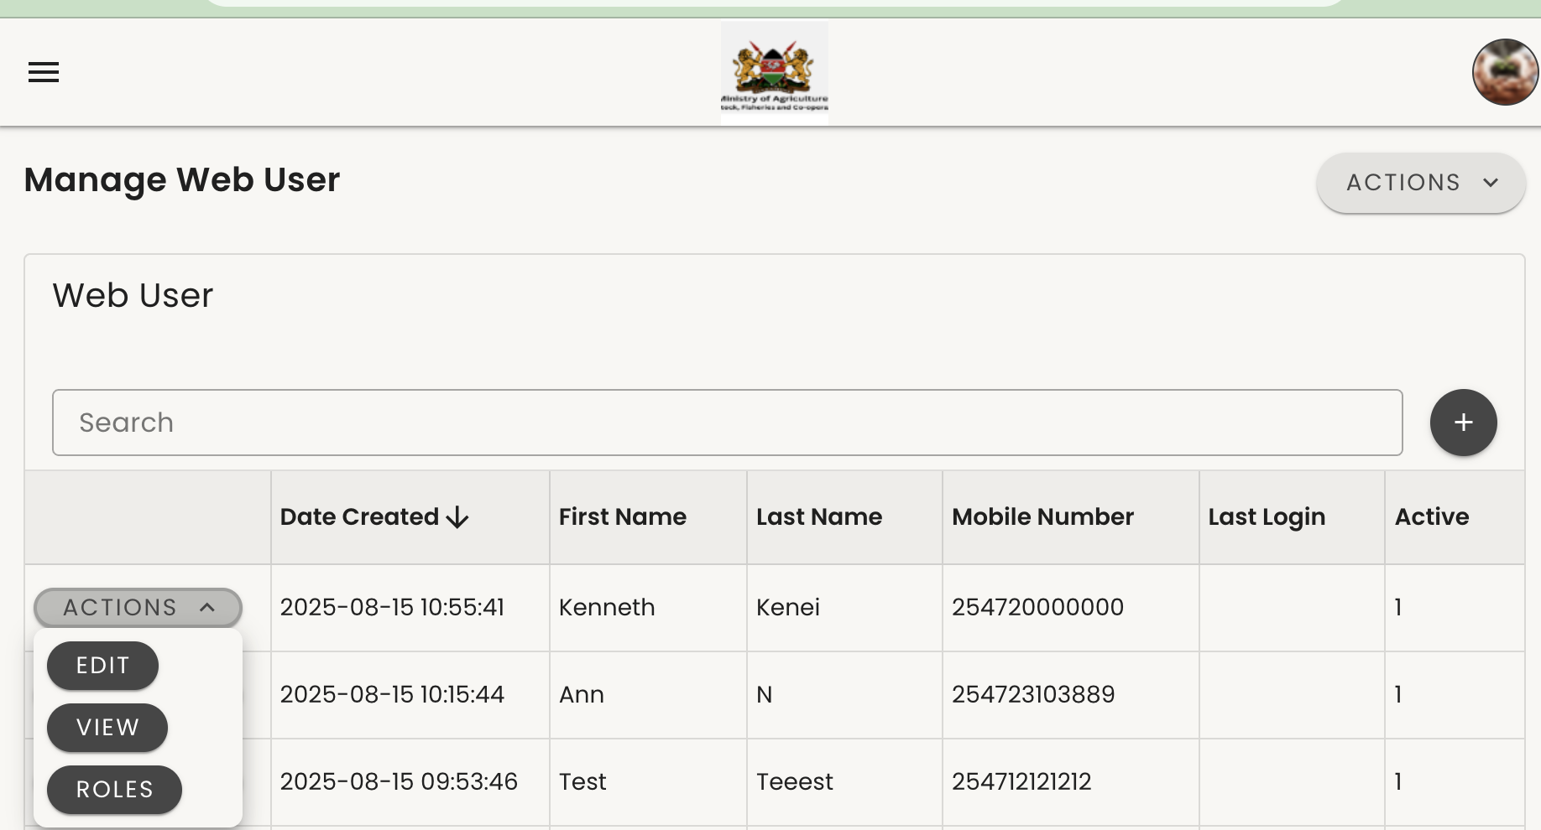
Manage User _Assign roles
Assigning Roles to a User
To assign roles to a newly created user:
If the user list is large and you cannot easily locate the user, use the Search bar.
  Enter the user’s mobile number, starting with the country code 254.
Once you locate the user, click the Actions button on the left side of their name.
A menu will appear with options such as Edit, View, and Roles.
Click Roles for the specific user to proceed with assigning their roles

Slide 12
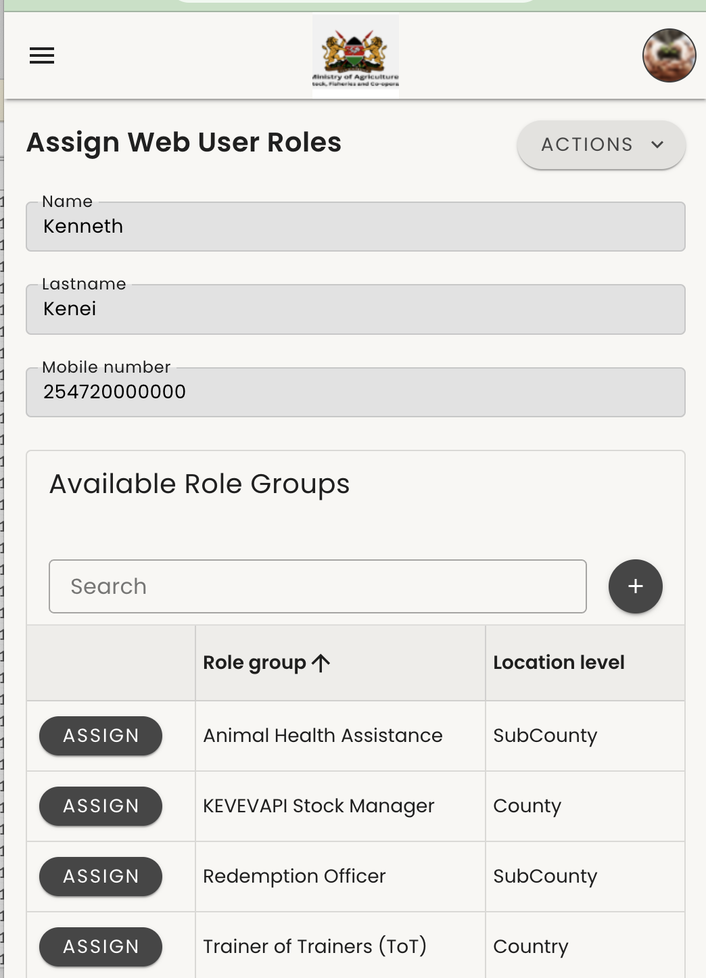
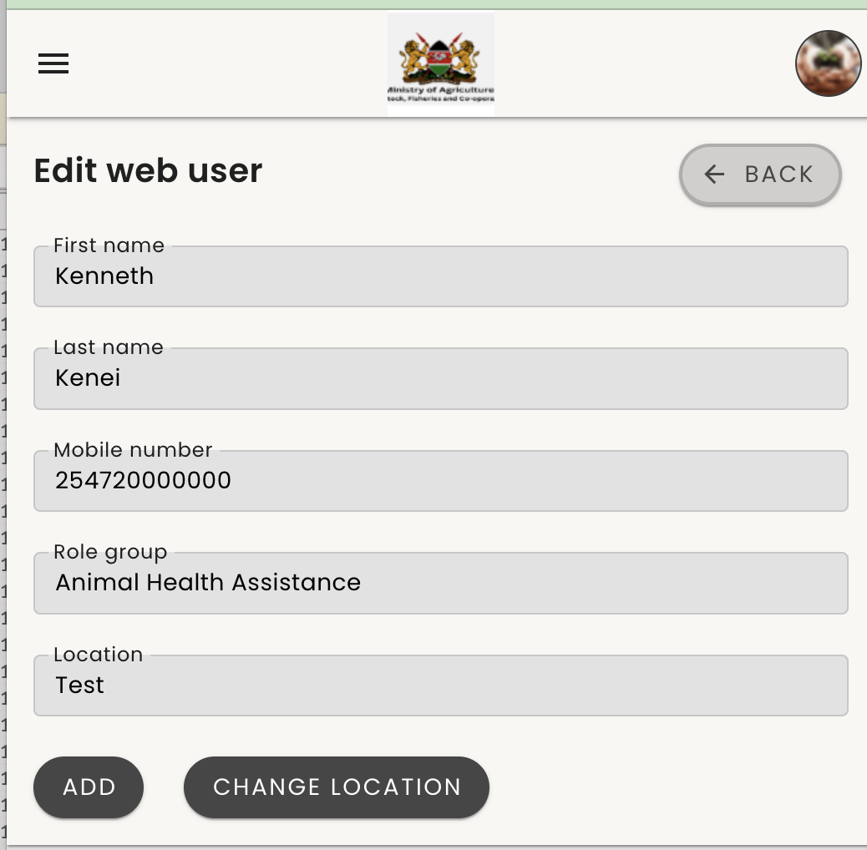
Manage User _Assign roles
Figure 1
Figure 1
Now, click “Assign” on the left side of the appropriate role to assign it to the user — for example, “Animal Health Assistance”.
Figure 2
Select the user’s location from the dropdown menu, then click “Add” to complete the assignment.
Figure 2

Slide 13
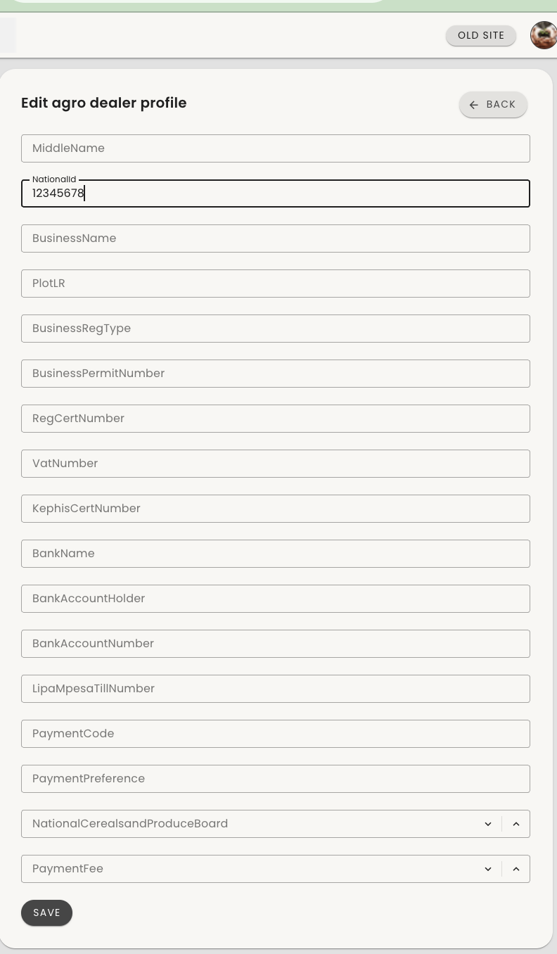
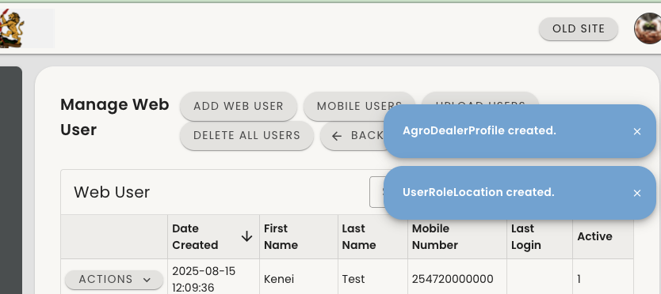
Manage User _Assign roles
Figure 1
Displays the AHS Profile.This is the account of the user to whom you are assigning a role. Enter only the ID number, then click Save.
Figure 2
Shows the successful assignment of the AHS role and the user’s profile.

Slide 14
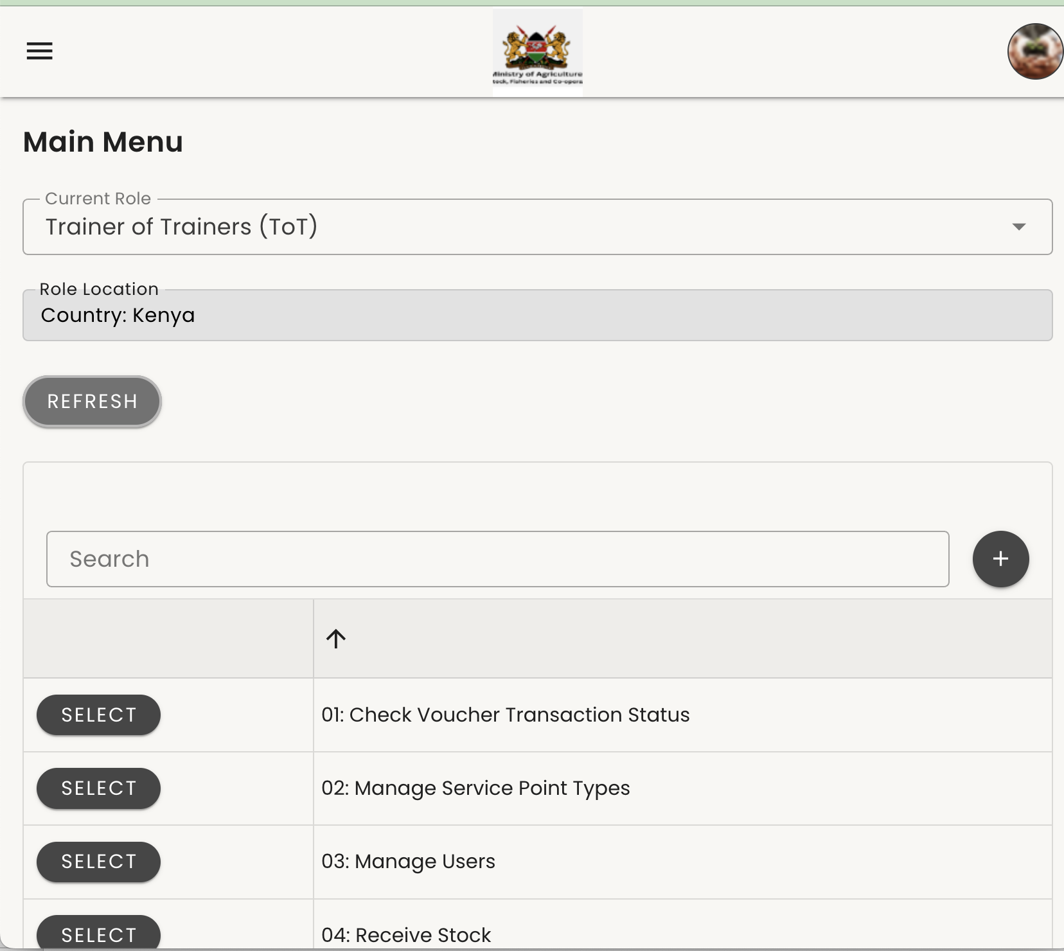
Manage Service Point Types
On the Main Menu, click the dropdown field next to "Current Role."
From the list of options that appears, select "Trainer of Trainers."
After selecting the role, click the "Refresh" button to load the relevant menu options for this role.
Click the "Select" button next to " Manage Service Point Types"

Slide 15
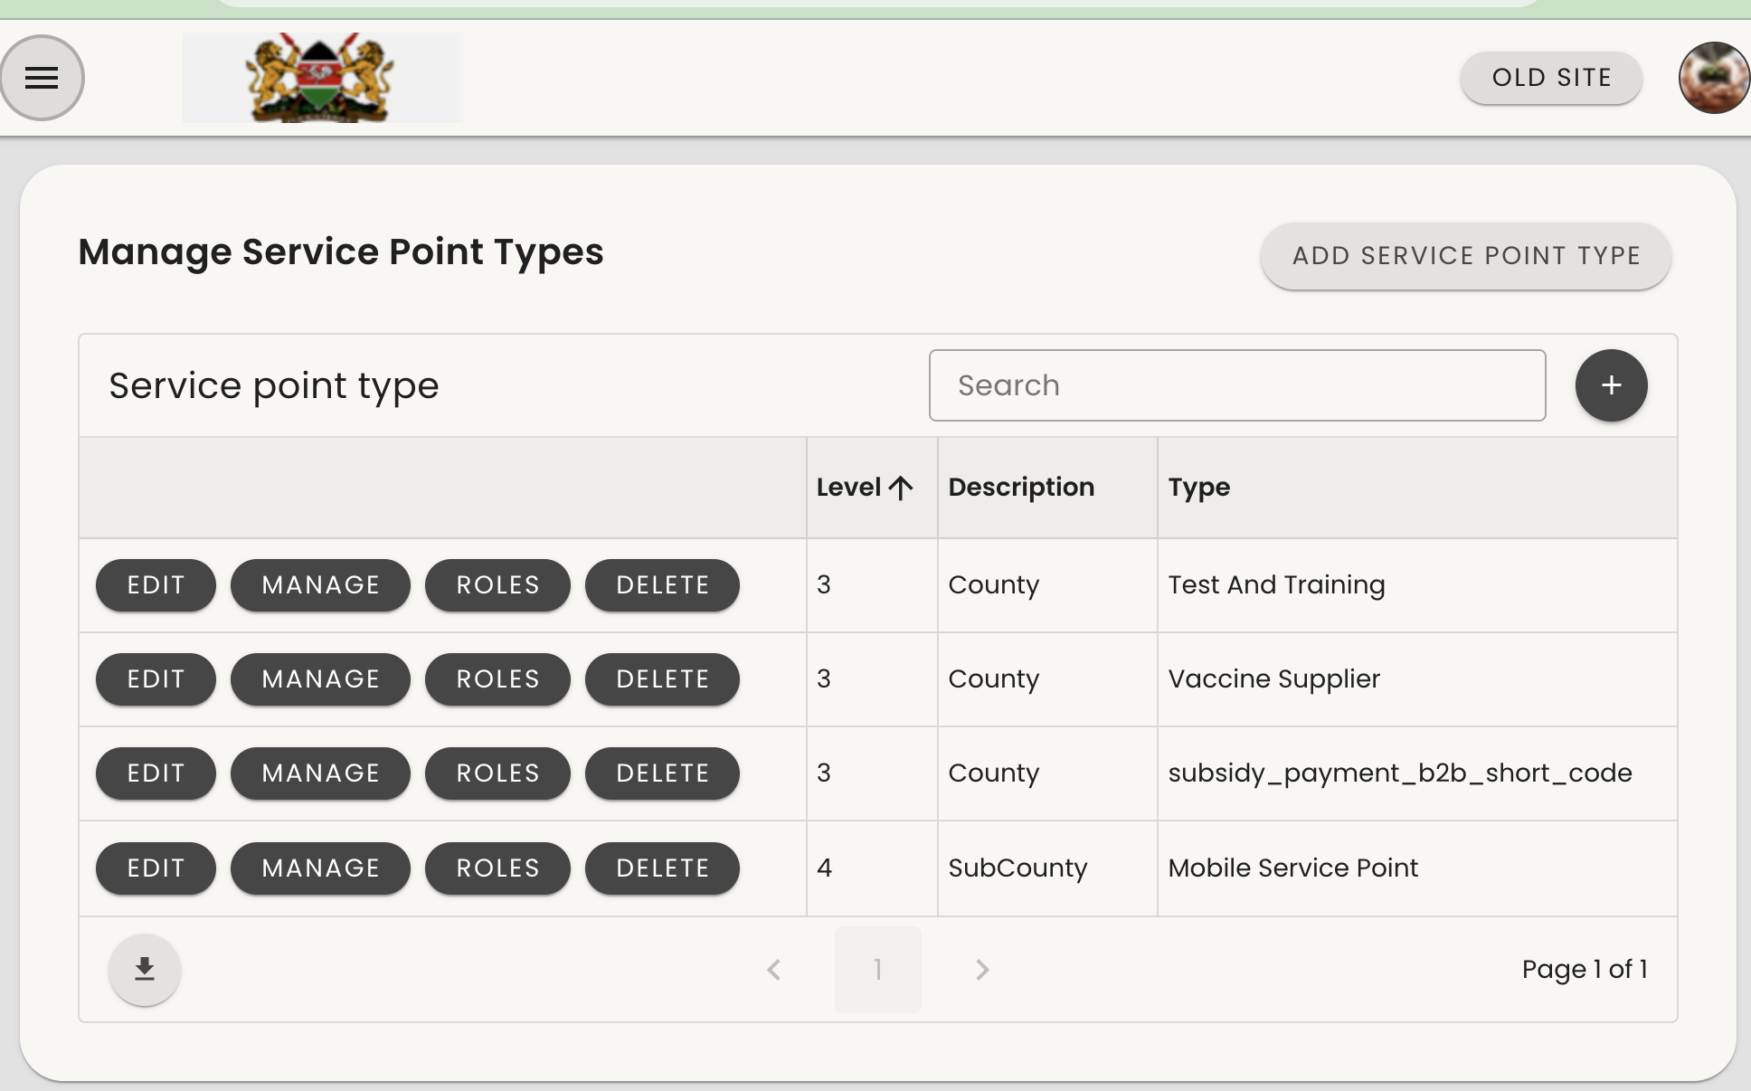
Manage Service Point Types
Service Points
Service Points refer to Virtual Agrovets for Veterinarians (Vets) and Animal Health Assistants (AHA), where beneficiaries or farmers can access services.
To add a live service point:
Click Manage in the left-hand side menu under Mobile Service Point.
For training purposes:
Click Manage in the left-hand side menu under Test and Training.
⚠ Important:
Do not click any other icon in this section if you are unsure of its purpose. For example, do not click Add Service Point Type (top right), as this is not used for creating service points—it serves a different purpose.

Slide 16
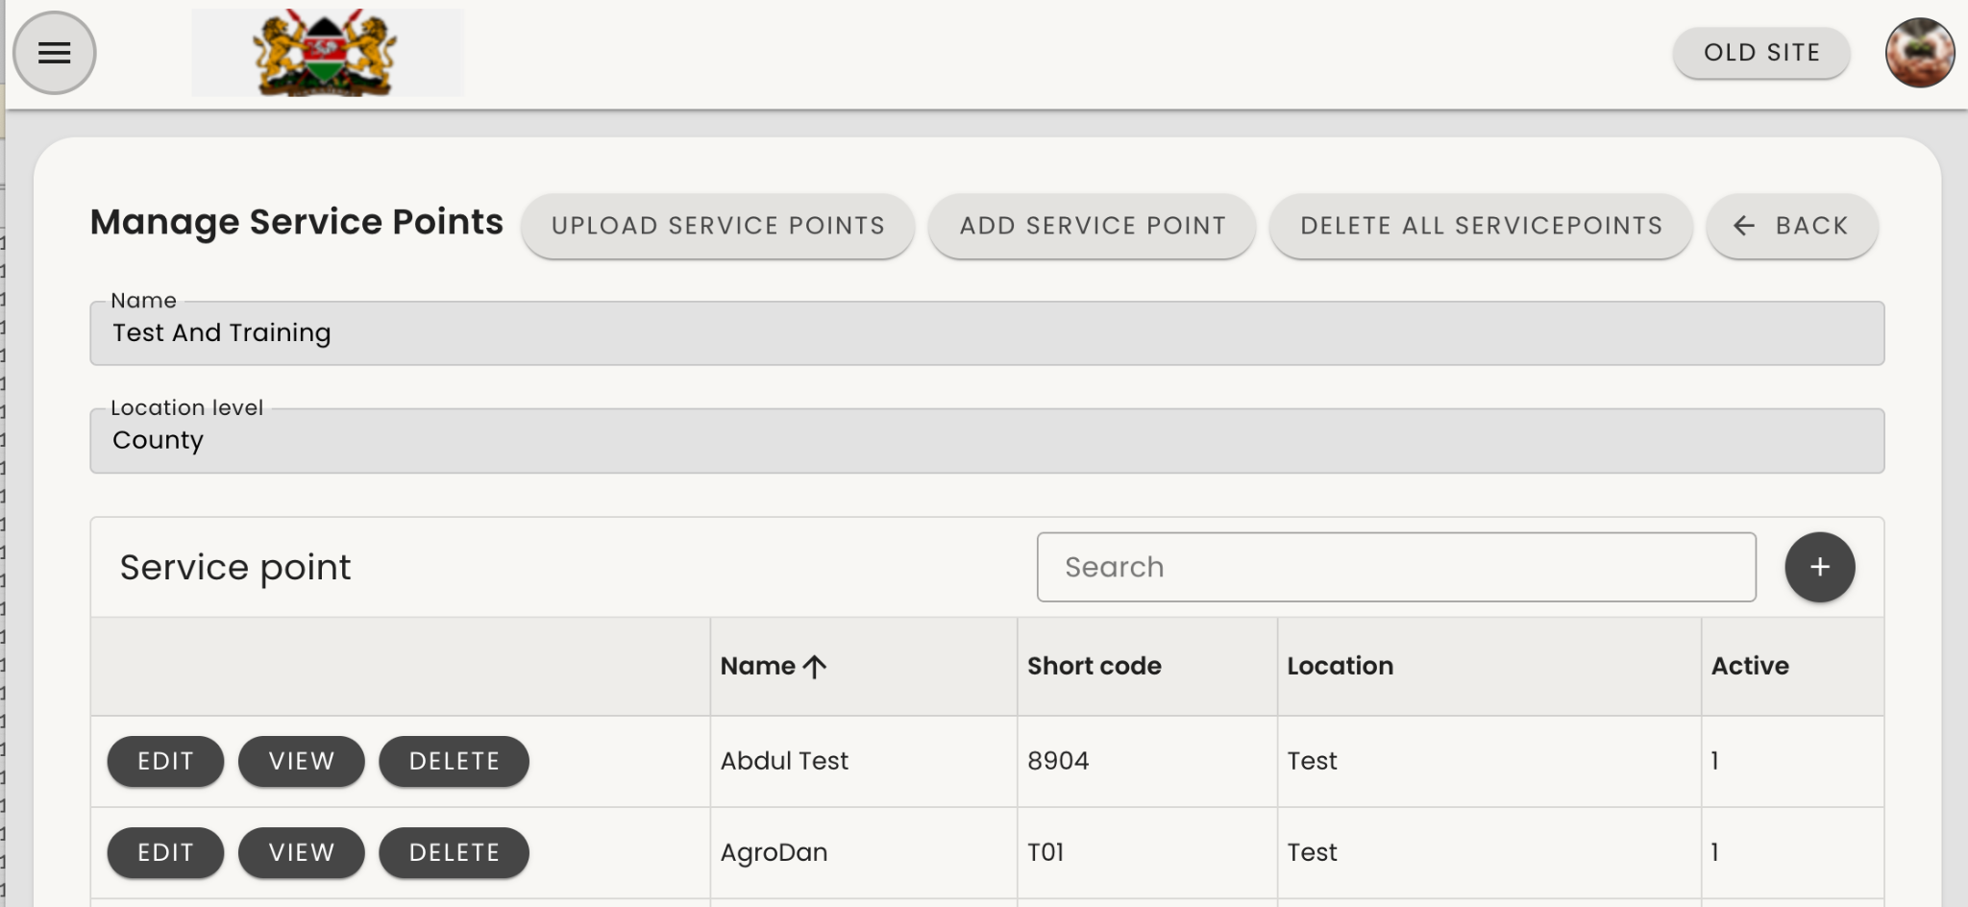
Manage Service Point Types
At the top or side panel, click "Add Service Points" to add a new shop.

Slide 17
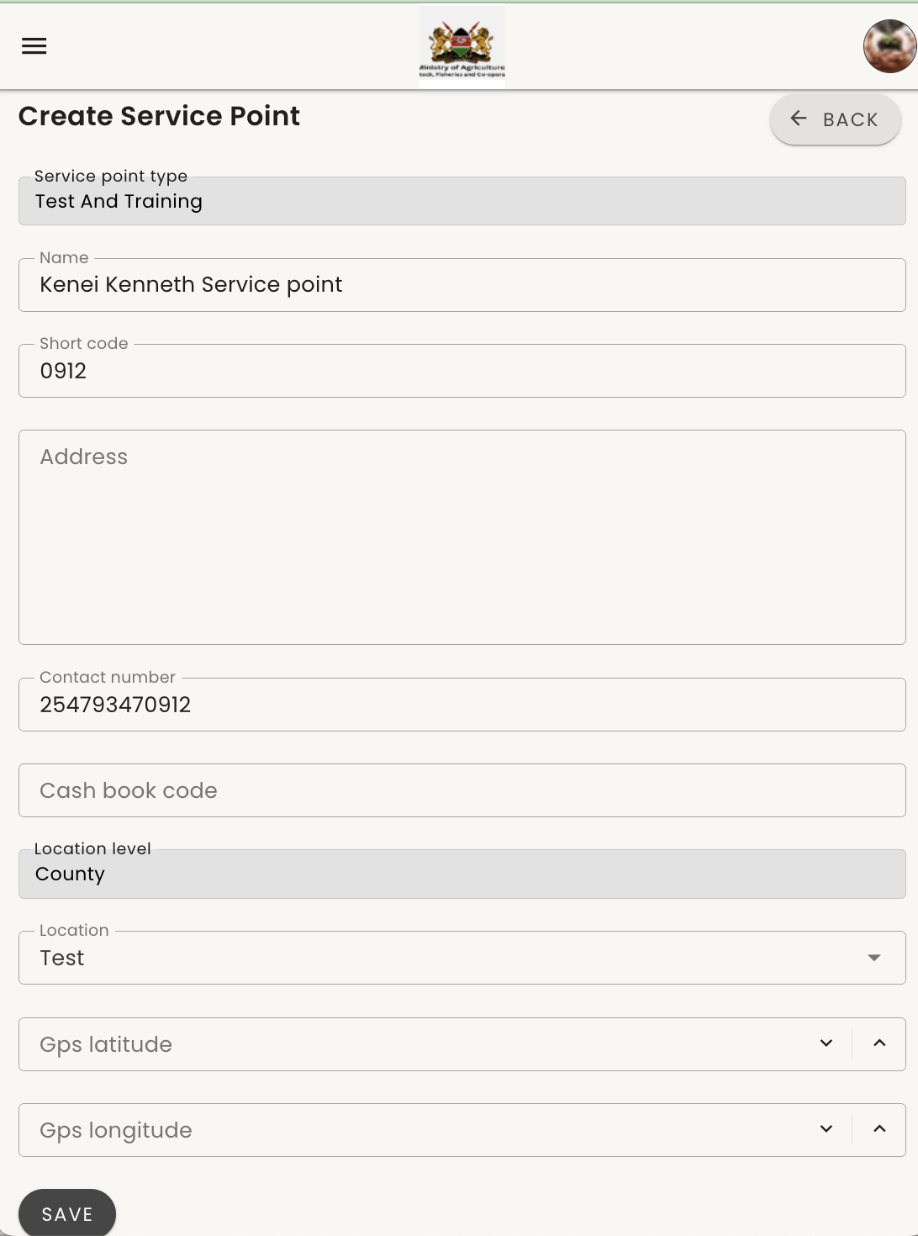
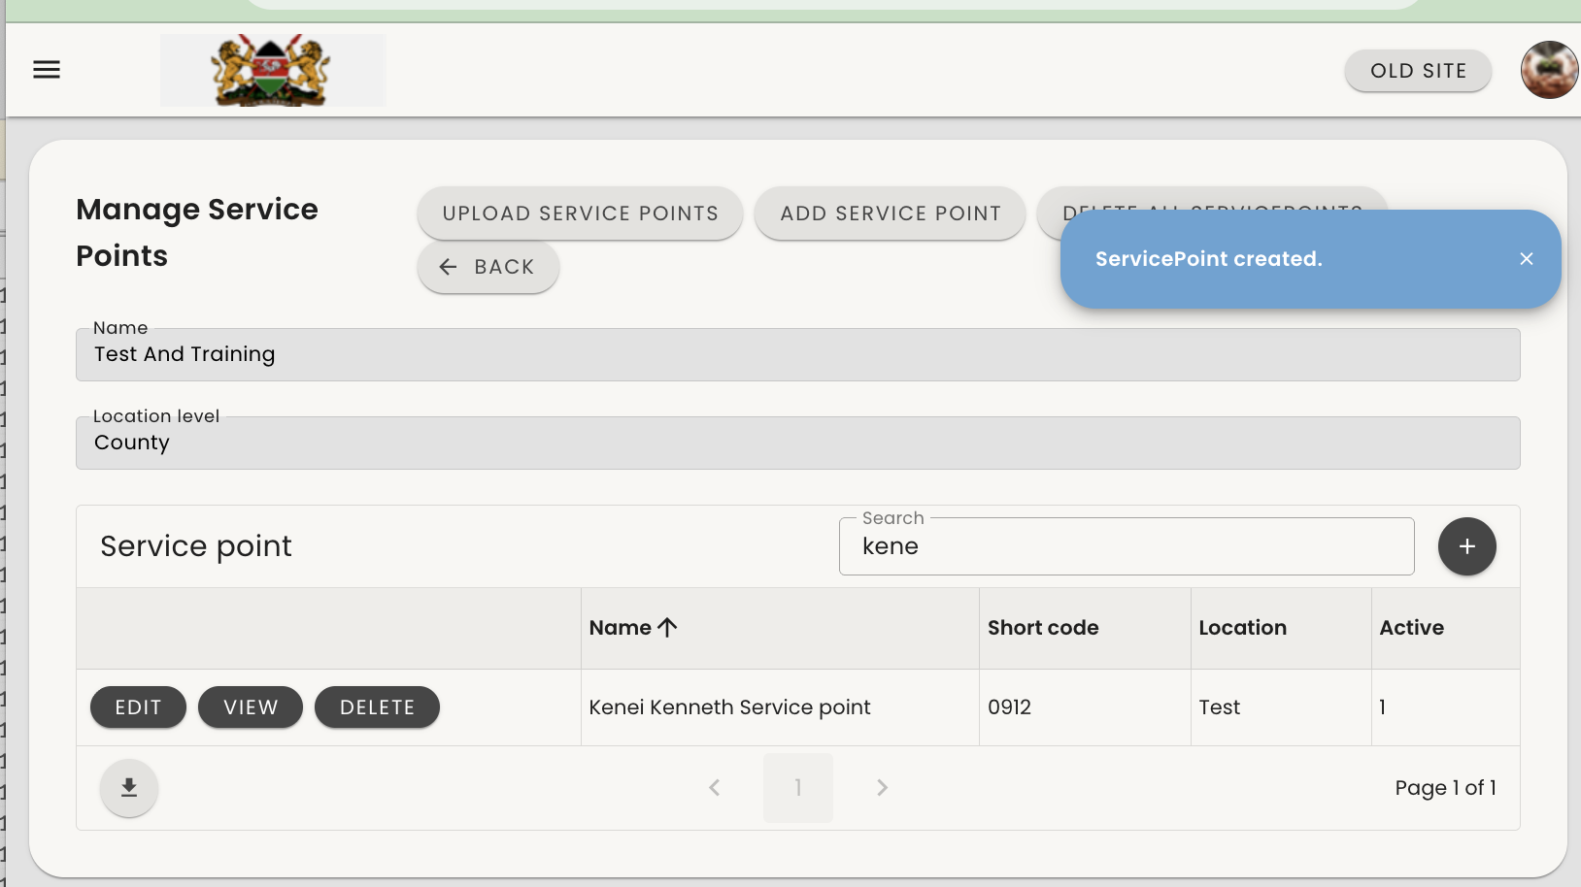
Manage Service Point Types
After selecting the correct location where the service point will be set up, fill in the required fields. Note: Not all fields are mandatory.
Enter the name of the service point as the full name of the AHS and add the word service point i.e Kenei kenneth service point
For the shortcode, use the last four digits of the AHS mobile number.
Enter the shopkeeper’s mobile number.
The location will already be populated based on your earlier selection.
You can ignore the GPS latitude and longitude fields if you do not have the coordinates.
Once all necessary details are filled in, click Save.
Your Agrovet will be created, and a blue pop-up will appear (as shown in Figure 2) confirming:
“Service Point Created.”

Slide 18
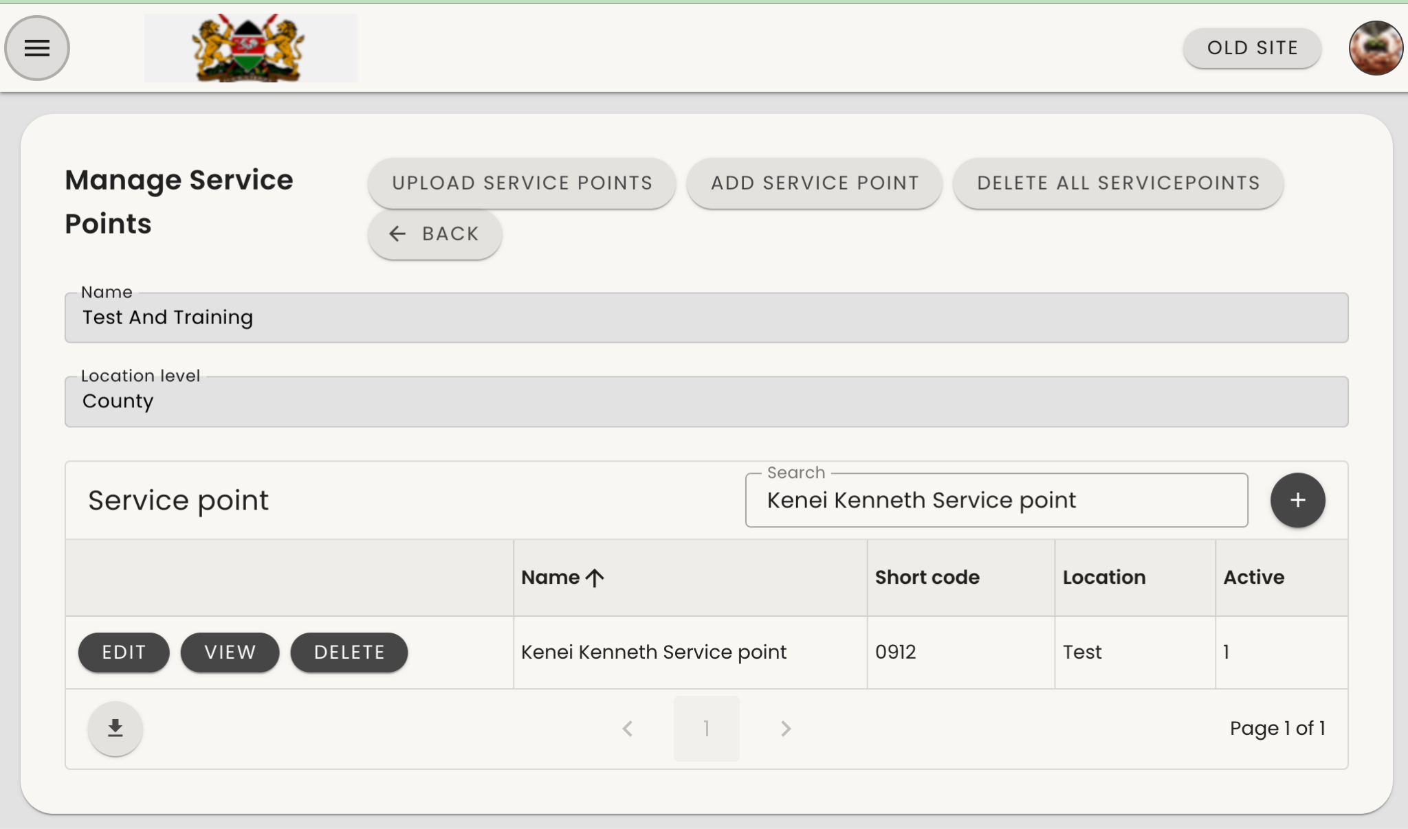
Manage Service Point Types_Assigning AHS to their agro vet/service point.
Assigning and Linking an AHS to a Service Point
Ensure that the AHS has been assigned the Animal Health Assistant role.
Go to Manage Service Points.
Search for the service point you created:
  If the list is large, use the Search bar and enter the name of the AHS you created.
Once you locate the service point, click View on the left side next to the shop name

Slide 19
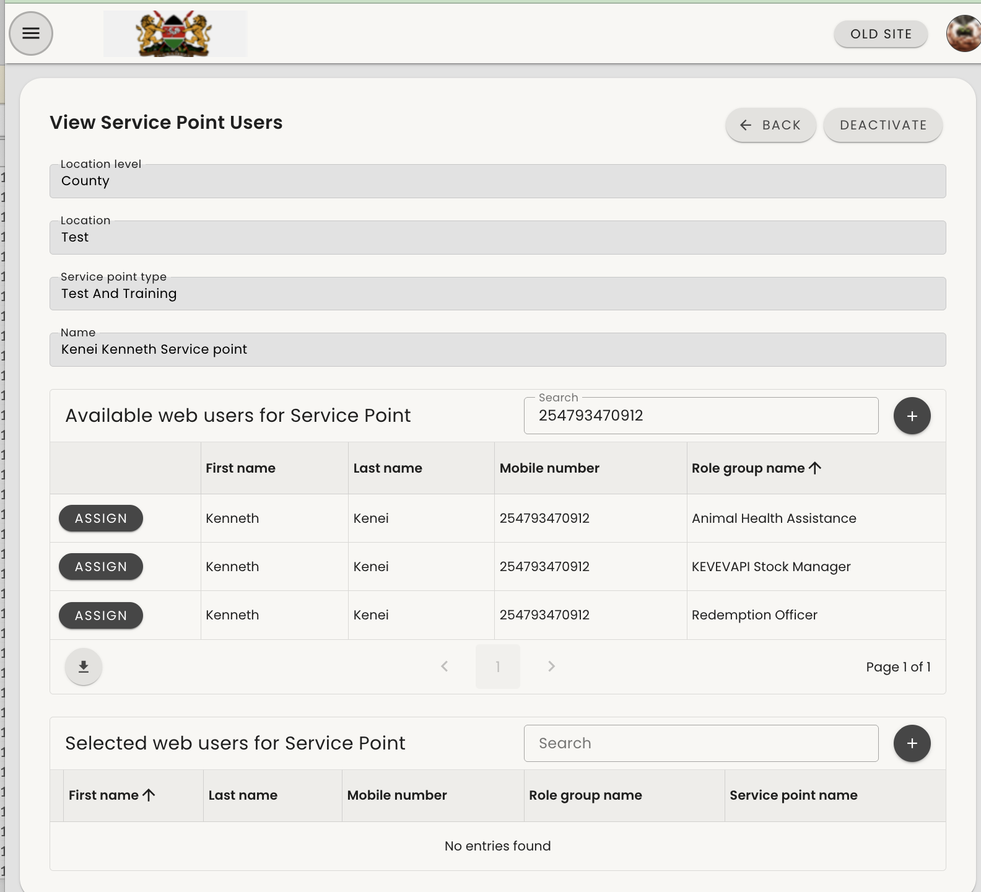
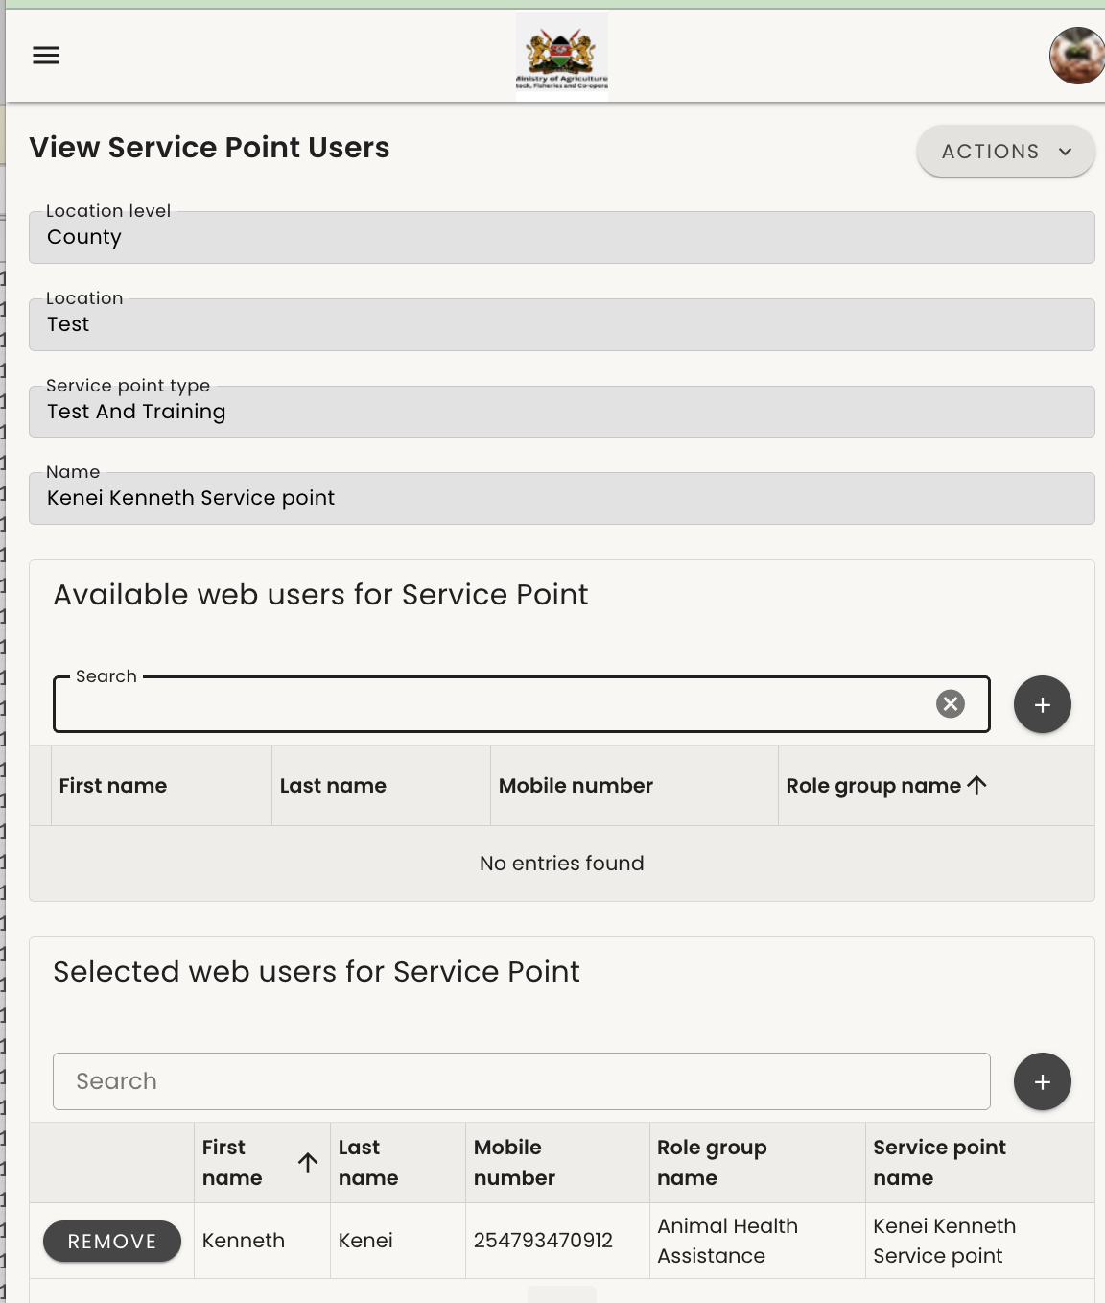
Manage Service Point Types_Assigning AHS to their agro vet/service point.
Figure 1
Figure 2
Figure 1:
Search for the AHS from the list you can also search using their mobile number and click "Assign." on the role AHS
Figure 2:
The AHS will now be successfully assigned to the service point, as shown. They will be able to redeem farmer vouchers via web..

Slide 20
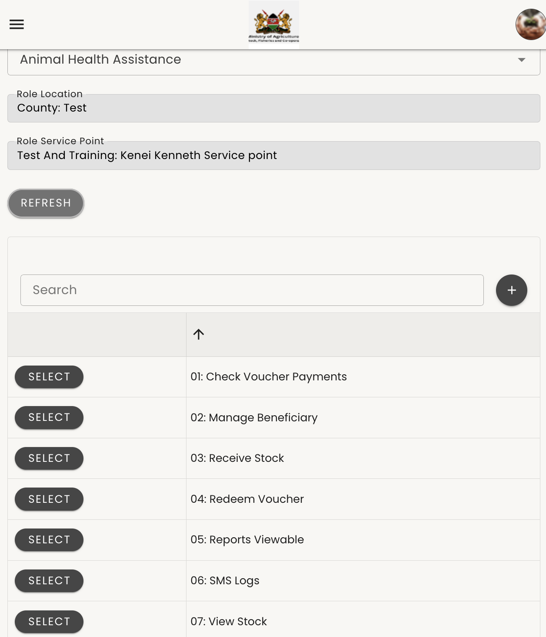
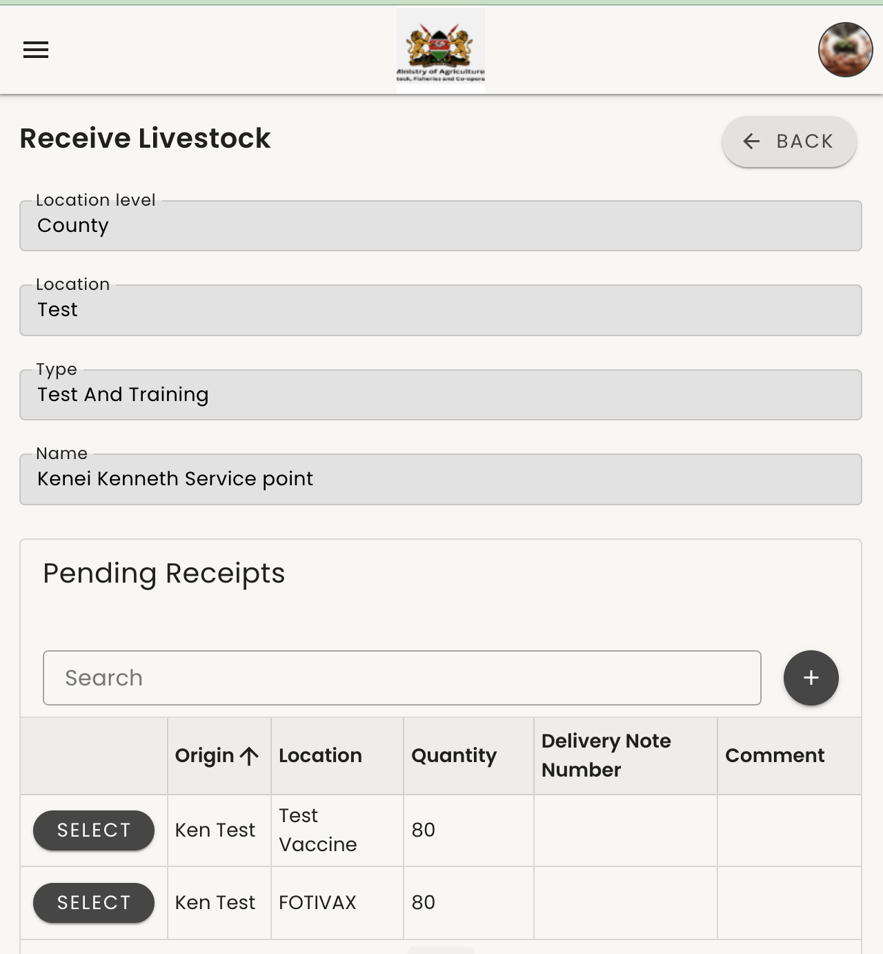
Receiving stock
Step 1: Logging In and Receiving Stock
Log in using a role of ToT or AHS.
  From the list, select Animal Health Assistant or ToT, then click Refresh to apply the role it functions the same.
Once the page refreshes, go to the left-hand menu and click Receive Stock.
  If you have pending stock from KEVEVAPI, it will appear in the list.
Figure 2: Shows pending stock transferred from KEVEVAPI. There may be more than one vaccine type (e.g., goat vaccine or cattle vaccine).
Select the stock item you have received.
If you have received both types, start with one type first and confirm that the quantity matches the physical stock before proceeding to the next.
Figure 1
Figure 2

Slide 21
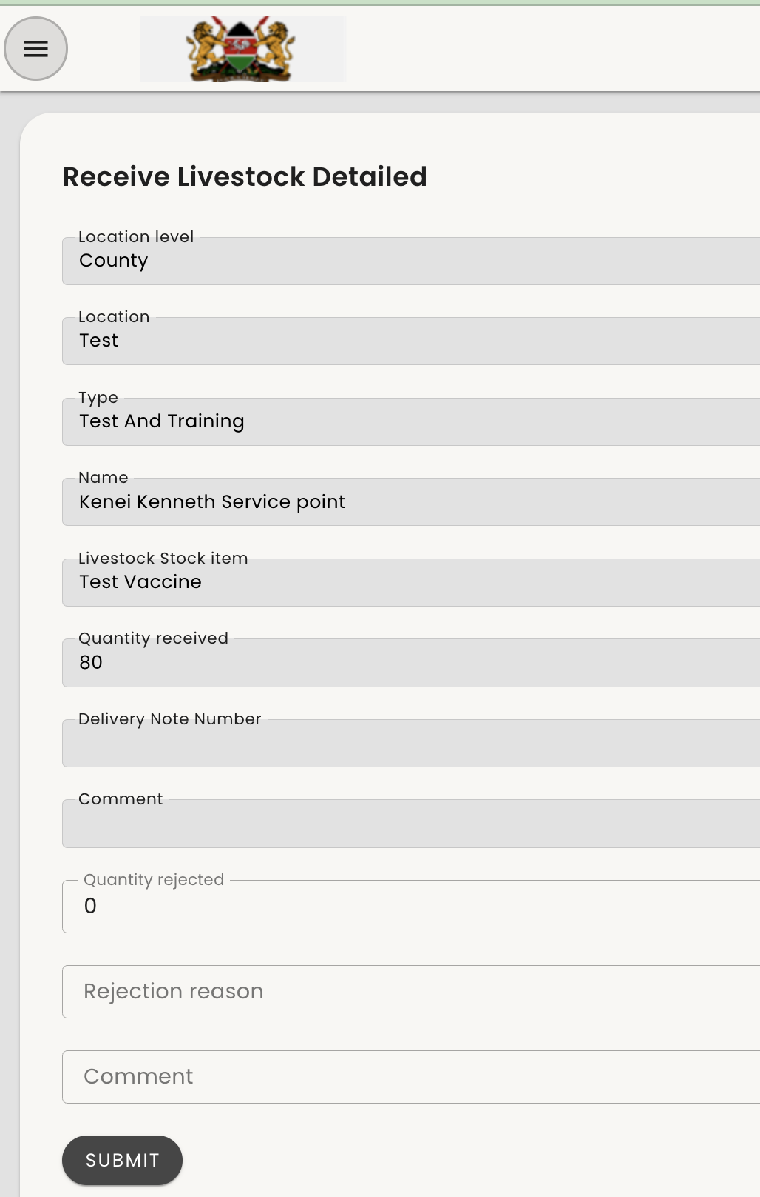
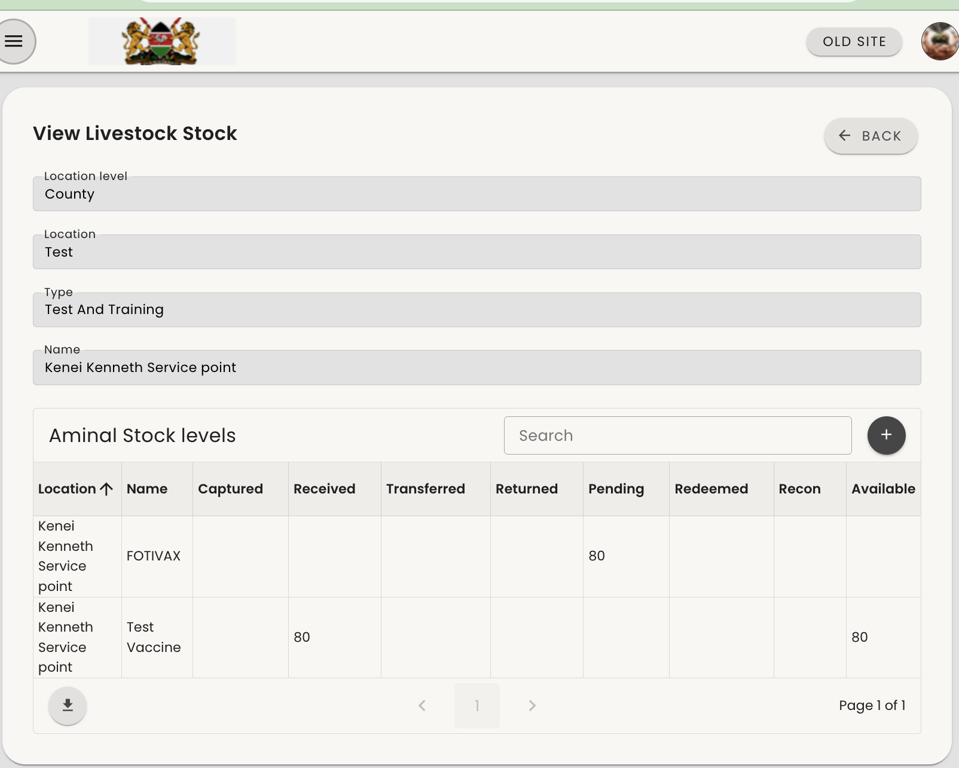
Receiving stock
Figure 1
Shows the vaccine details for your service point.
Confirm the page displays your service point name.
If the physical stock matches the system quantity, click Submit.
For damaged vaccines, enter the quantity in Quantity Rejected and select a reason.
If stock matches, leave 0 in Quantity Rejected.
If the vaccine name differs from what is in the system, contact support.
Figure 2
After clicking Submit, your received stock appears as Available Balance.
Pending stock (e.g., 80) means it is still in transit.
You can now redeem vaccines; the balance will reduce as they are used.
Figure 1
Figure 2

Slide 22
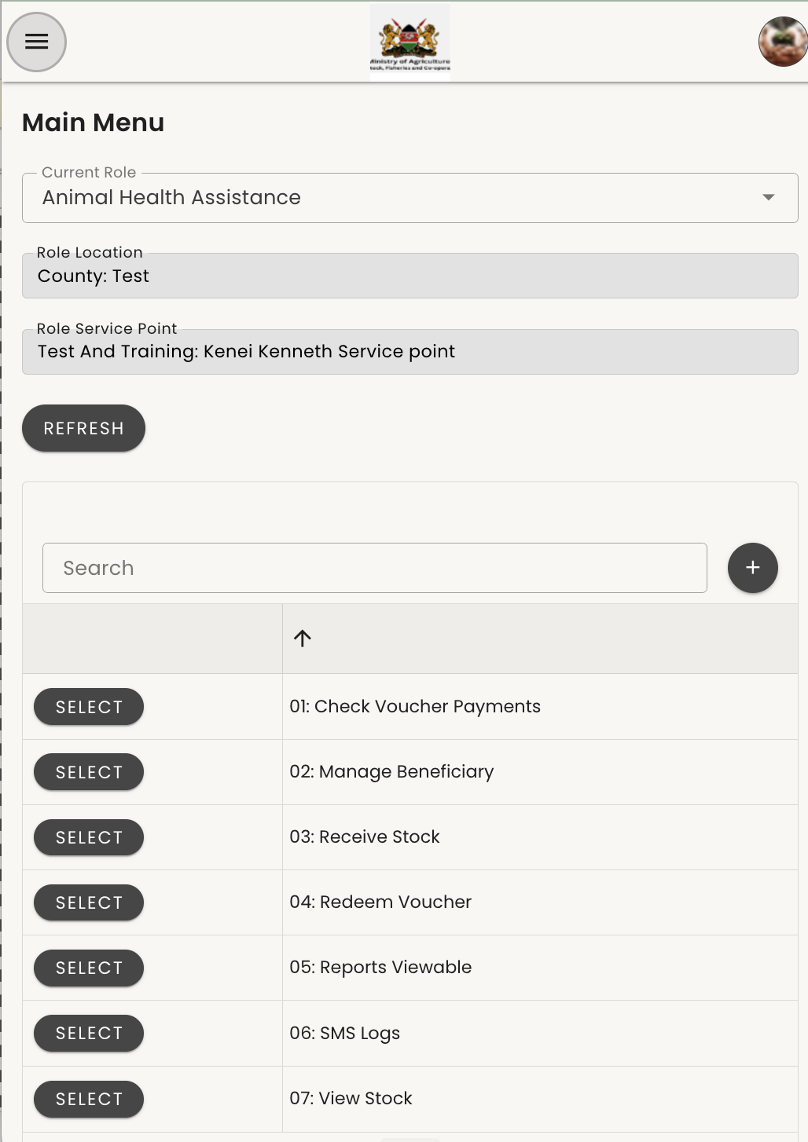
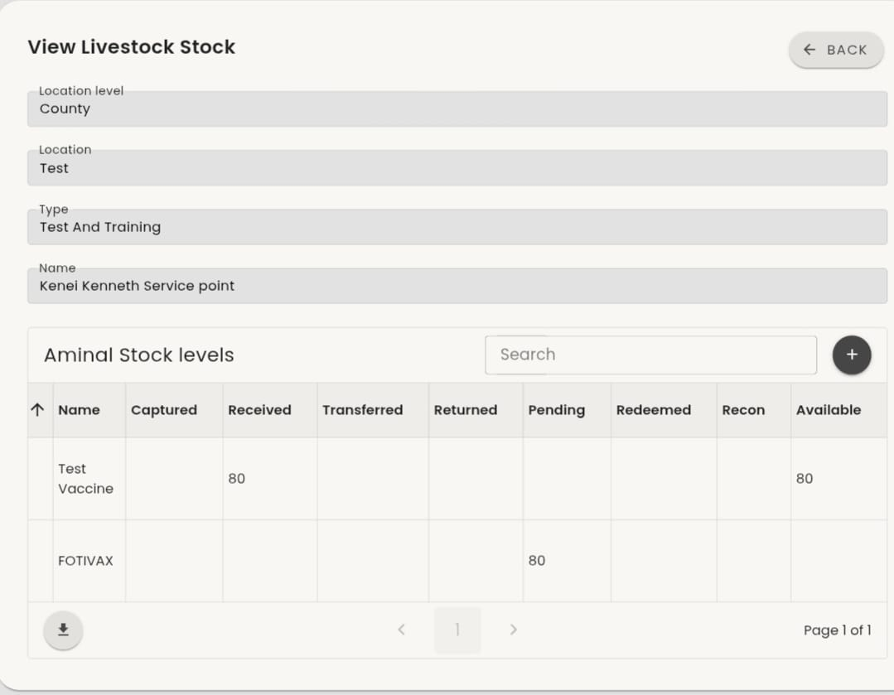
View stock
Figure 2
Figure 1
To view stock balance, sign in with the ToT or AHS role, then click Select next to View Stock Balance.
Figure 2
Displays your stock status: the first item shows as Available (already received), while the second shows as Pending and can only be received once the physical commodity is confirmed.
Figure 1

Slide 23
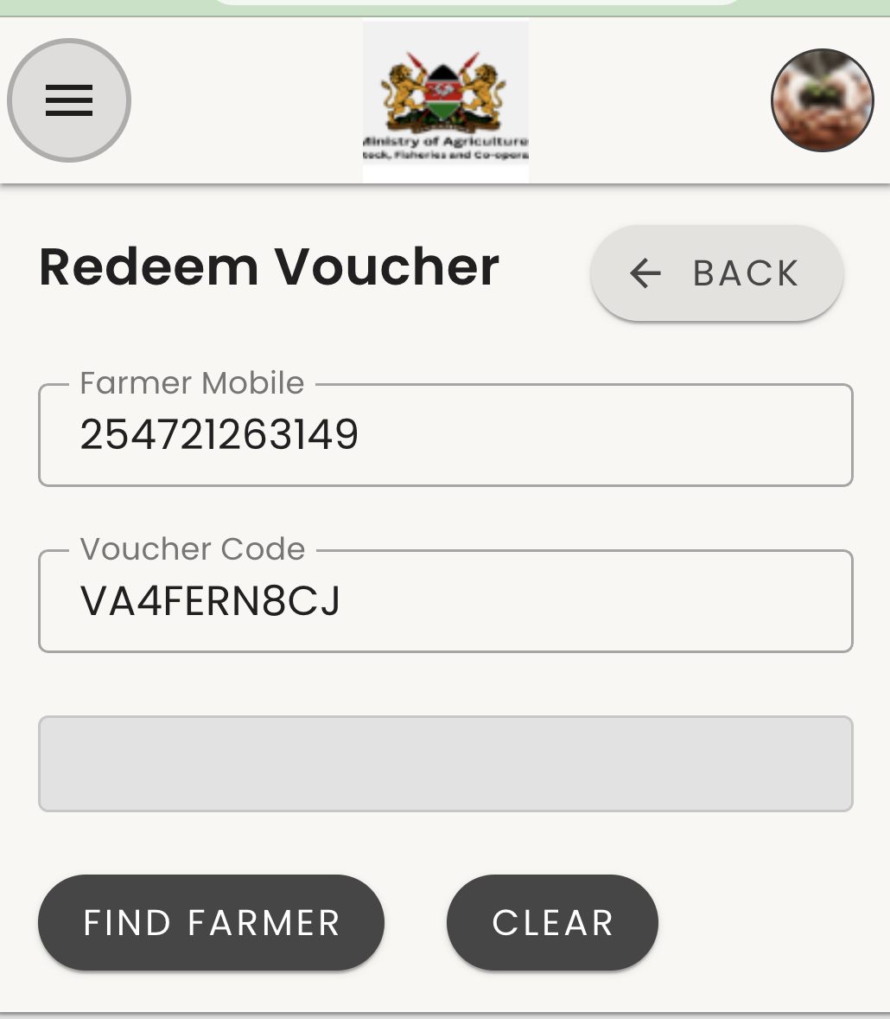
Redeem Voucher
Figure 1
Sign in with your ToT or AHA role and click Refresh. Confirm the service point name is yours, as it records the farmers you serve and the vaccines you use.
Figure 2
Enter the farmer’s mobile number starting with 254 (no “+”), i.e 254793470912 then the remaining digits. Enter the voucher code exactly as in the farmer’s SMS, and click Find Farmer.
Figure 1
Figure 2

Slide 24
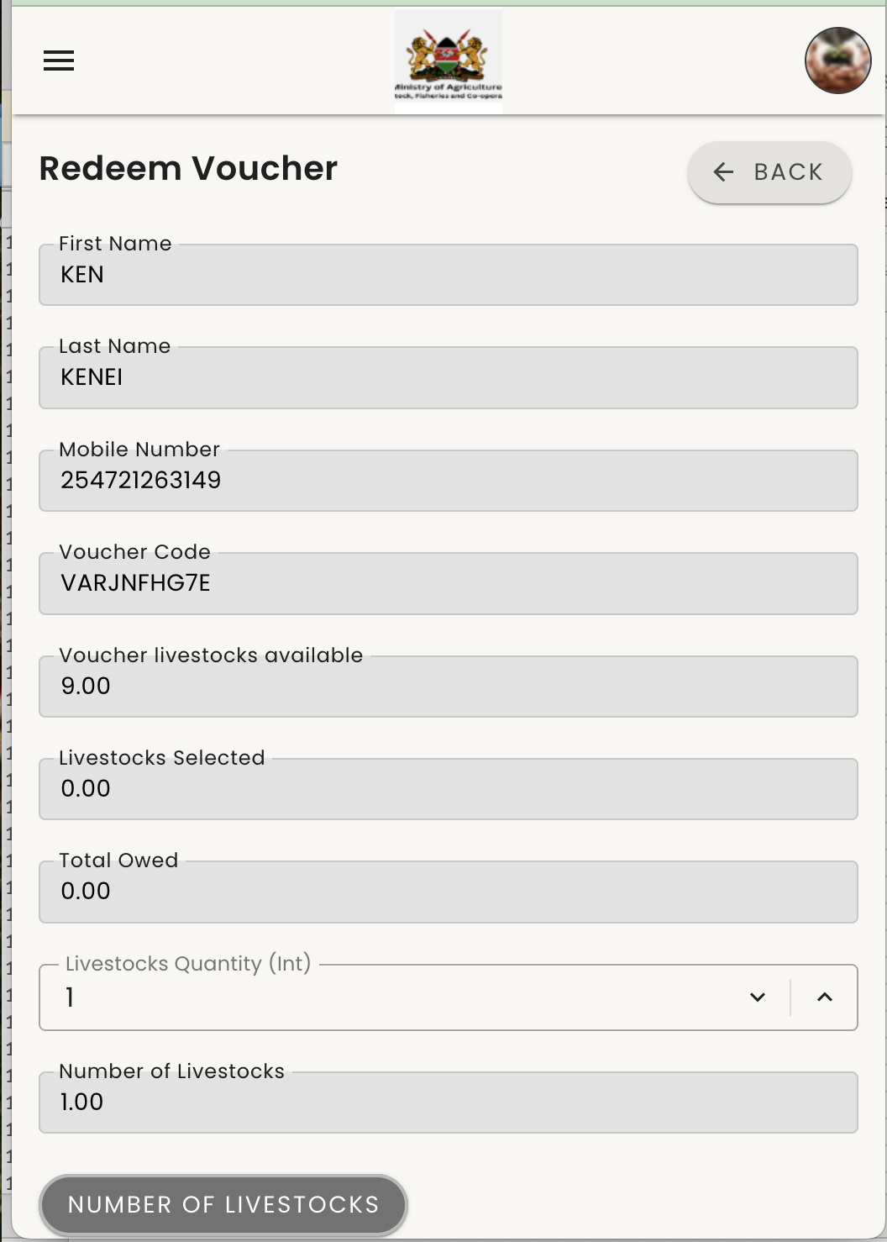
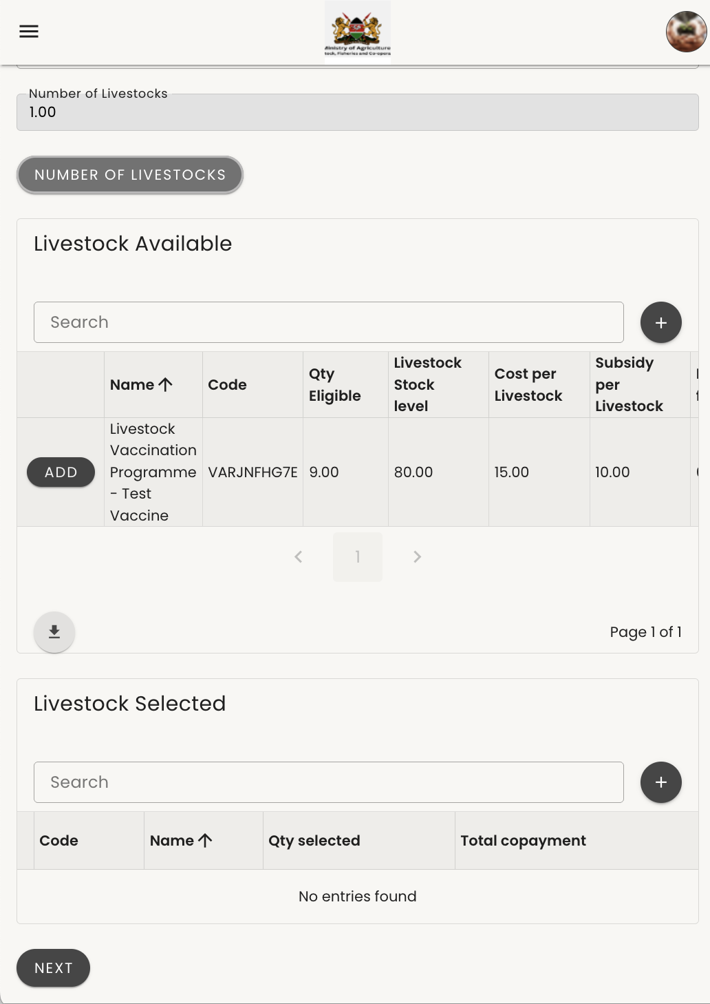
Redeem Voucher
Figure 1
Displays the farmer’s details, voucher code, and the number of livestock linked to the voucher. Enter the number of livestock vaccinated and click the Number of Livestock icon to set it.
Figure 2
After setting the number of livestock vaccinated in Figure 1, the vaccines linked to the voucher are displayed along with your available balance and cost per vaccine. Click Add to add the vaccine to the cart.
Figure 1
Figure 2

Slide 25
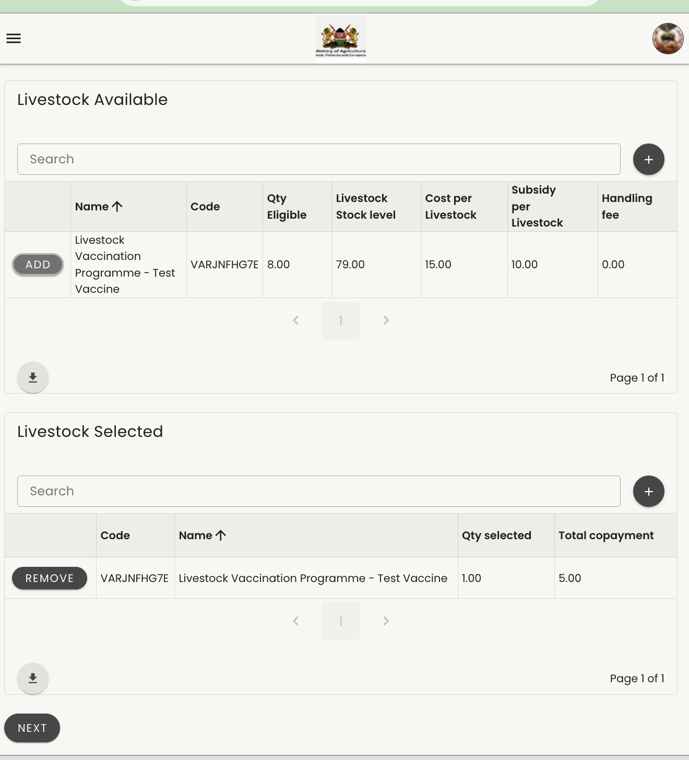
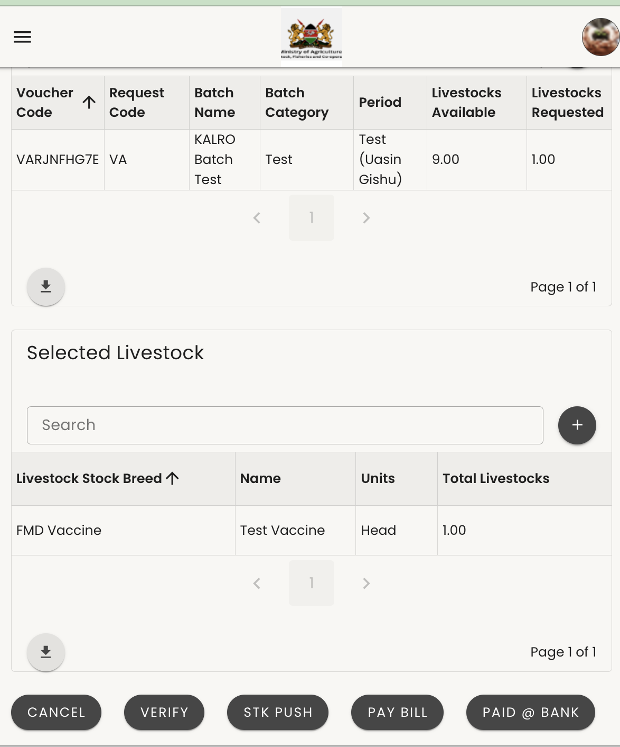
Redeem Voucher
Figure 1
Shows the vaccines you selected and the total payment expected from the farmer. Click Next to go to the payment page.
Figure 2_Payment Page
Confirm you selected the correct vaccine.
Cancel – cancels the payment process.
Verify – sends the farmer an SMS with the amount due (for Airtel, Telkom, and other networks).
STK Push – for Safaricom farmers; prompts them to enter their M-PESA PIN so the system can deduct the exact amount automatically.
Paybill – for Airtel farmers.
Paid at Bank – for farmers who have paid amounts exceeding KSh 500,000 via bank transfer.
For Safaricom farmers, click STK Push to request payment via M-PESA.
Figure 1
Figure 2

Slide 26
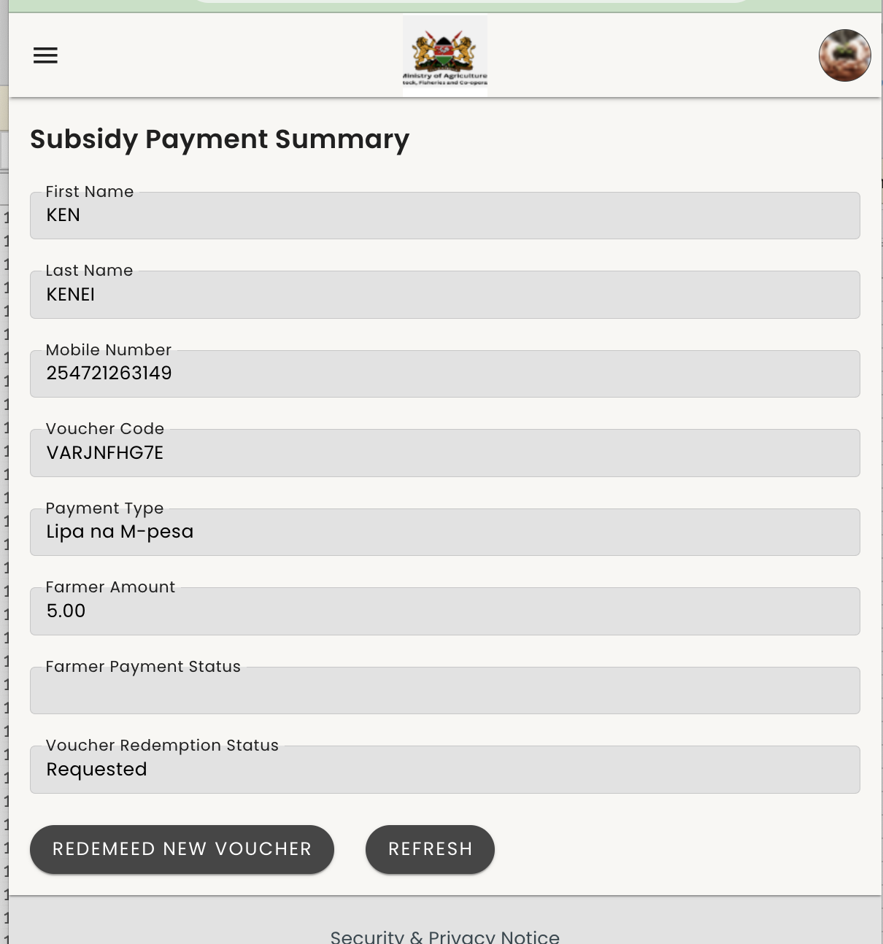

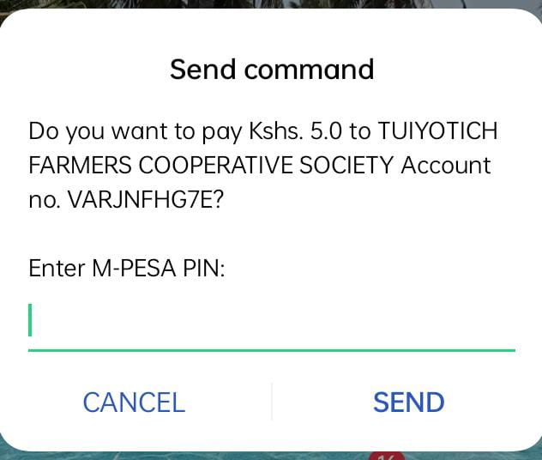
Redeem Voucher
Figure 1
The Subsidy Payment page appears after an STK Push is sent to the farmer. It shows the amount due and the voucher redemption status (“Requested”). Once the farmer enters their M-PESA PIN and the payment is confirmed, click Refresh to update the status.
Figure 2
Shows the farmer’s phone after receiving the STK Push prompt. The farmer confirms payment to the cooperative society account by entering their PIN. After payment, click Refresh in the system.

Slide 27
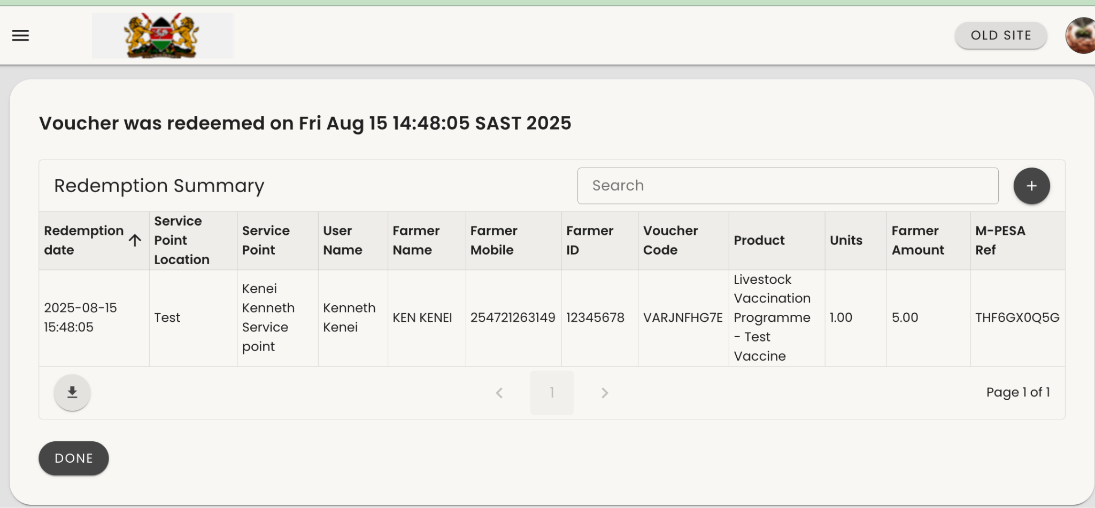
Redeem Voucher
After successful payment, a receipt pops up immediately when you click Refresh on the previous page.
Click done.

Slide 28
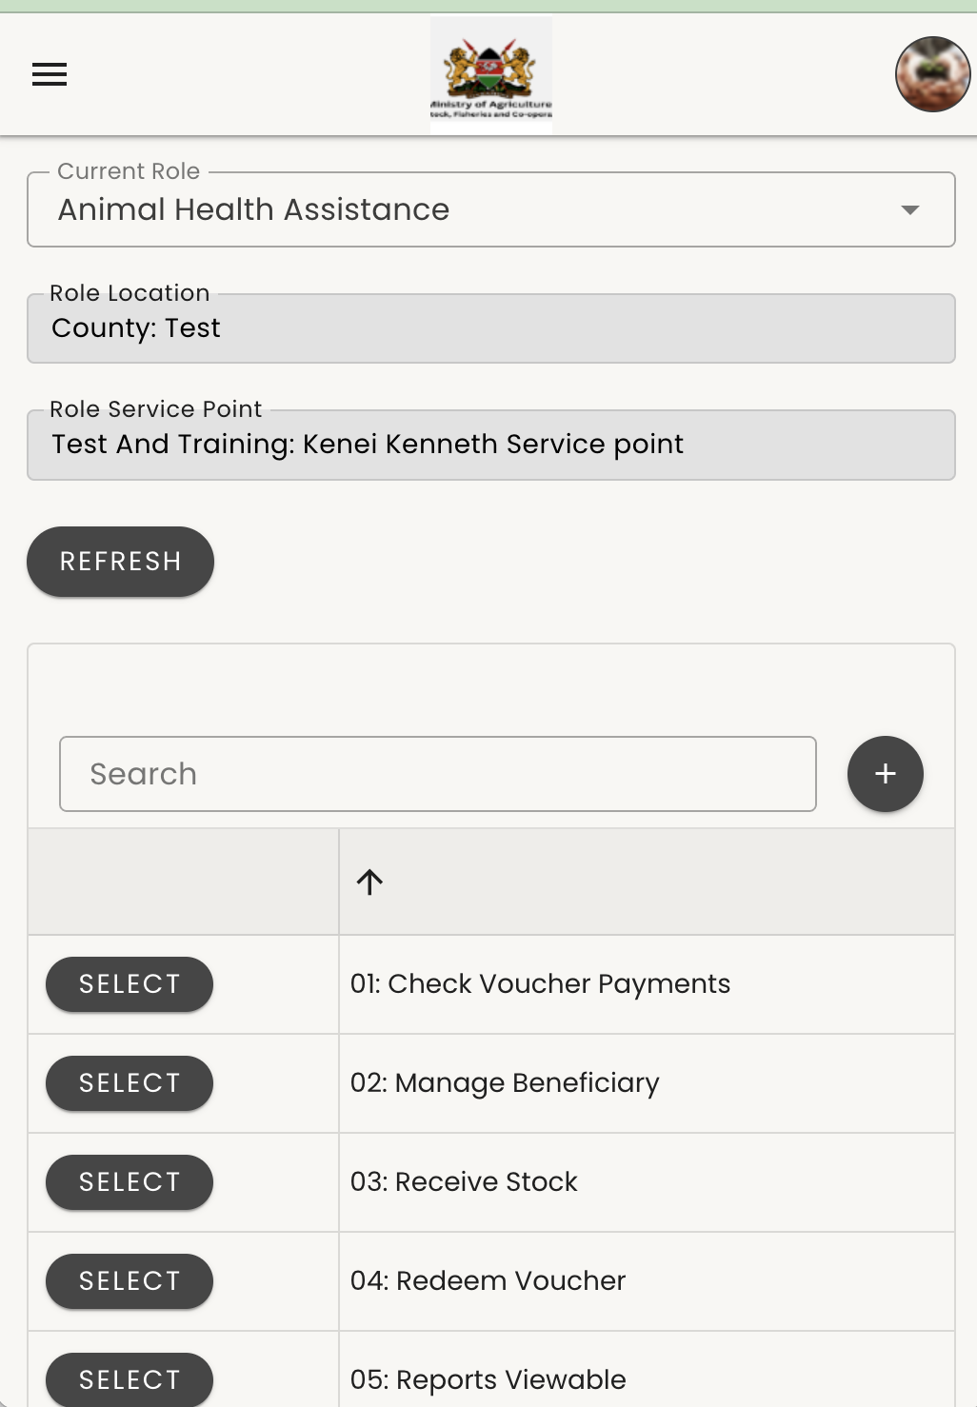
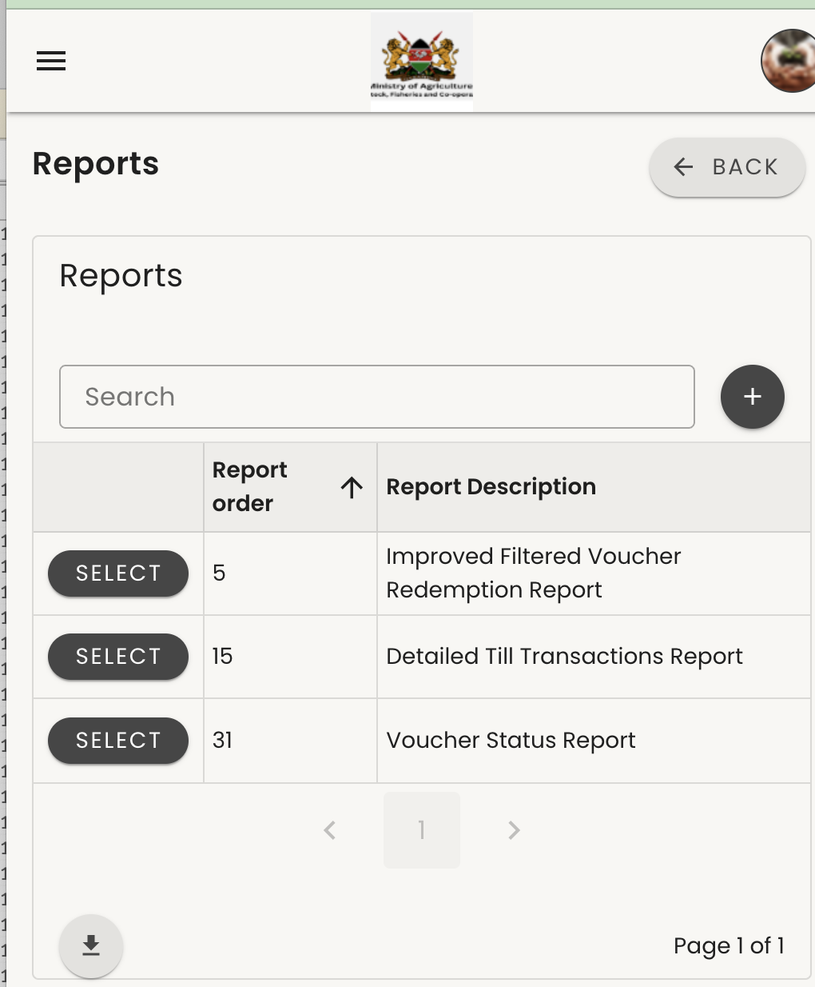
Report Viewable
Figure 1
As an AHS or ToT, click Reports under the viewable section.
Figure 2
Select Improved Filtered Voucher Redemption Report from the list.

Slide 29
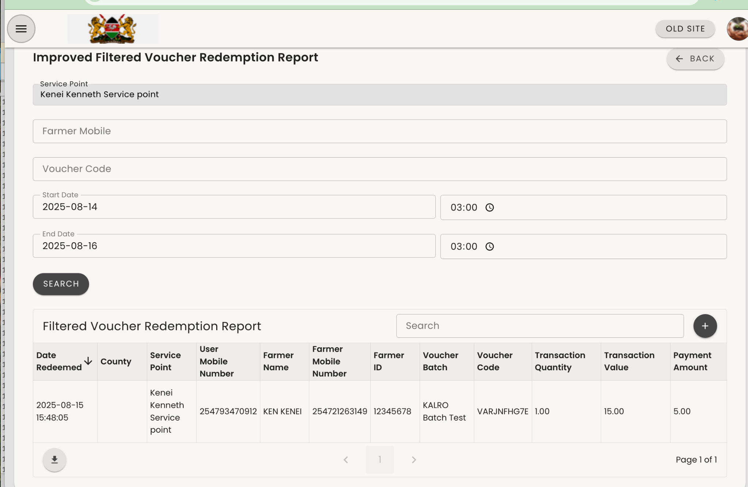
Report Viewable
Improved Filtered Voucher Redemption Report
This report provides a summary of farmer details, including name, vaccine type, livestock vaccinated, amount paid, number of vaccines, and more. To download, click the dropdown arrow on the left side.

Slide 30
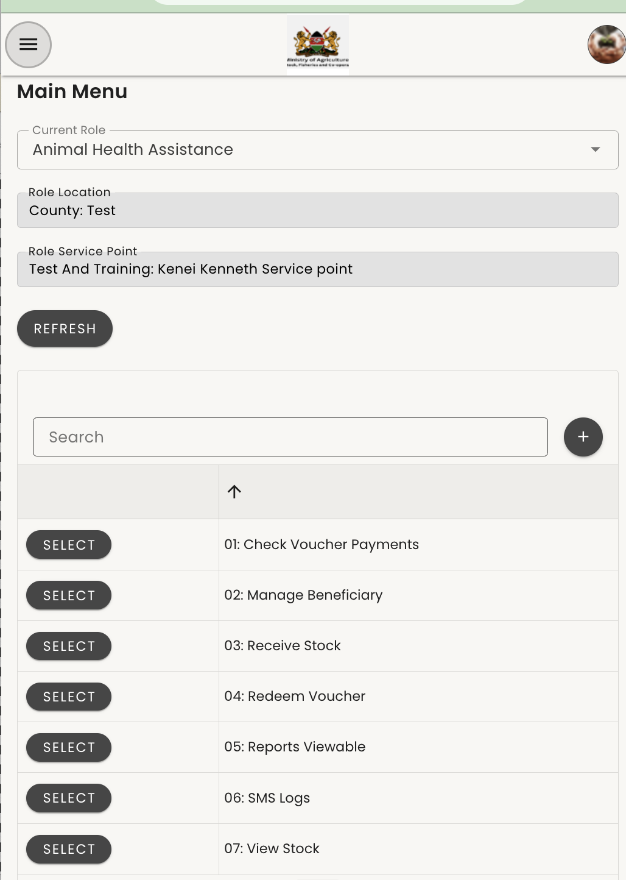
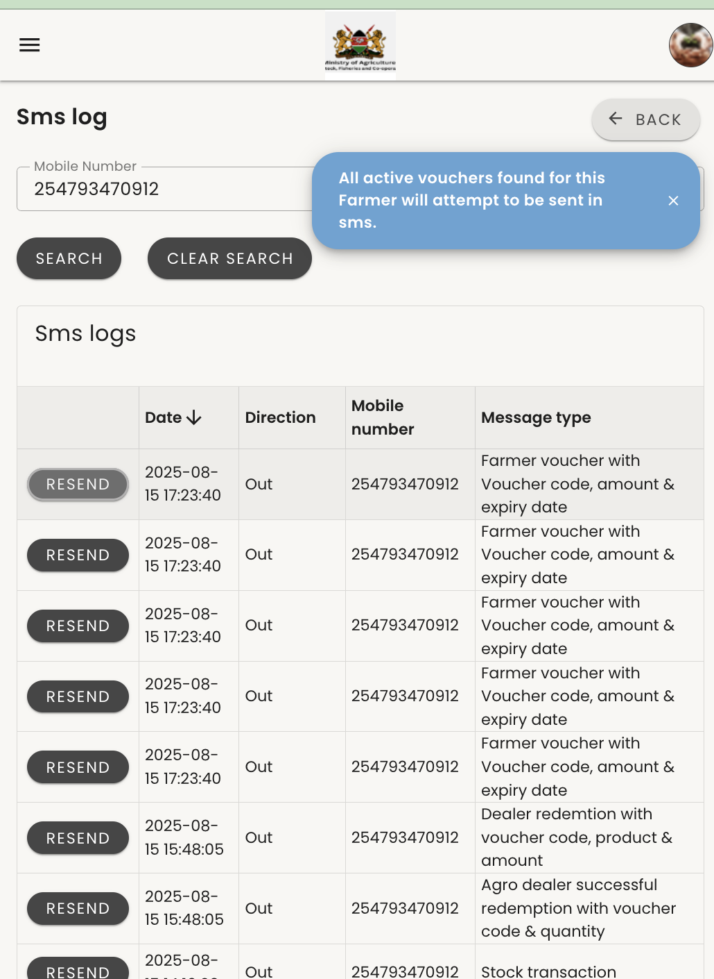
sms logs_Resending Vouchers
SMS Logs work in all cases where a farmer has active voucher codes but has deleted messages or changed their phone device.
Figure 1
Log in as an AHS or Trainer of Trainers, click Refresh, then select SMS Logs.
Figure 2
Enter the farmer’s mobile number and click Search. The SMS logs will be displayed, but the voucher code will be hidden. Click Resend next to the message type Farmer Voucher (which contains the voucher code, amount, and expiry date) to resend all vouchers to the farmer.

Slide 31
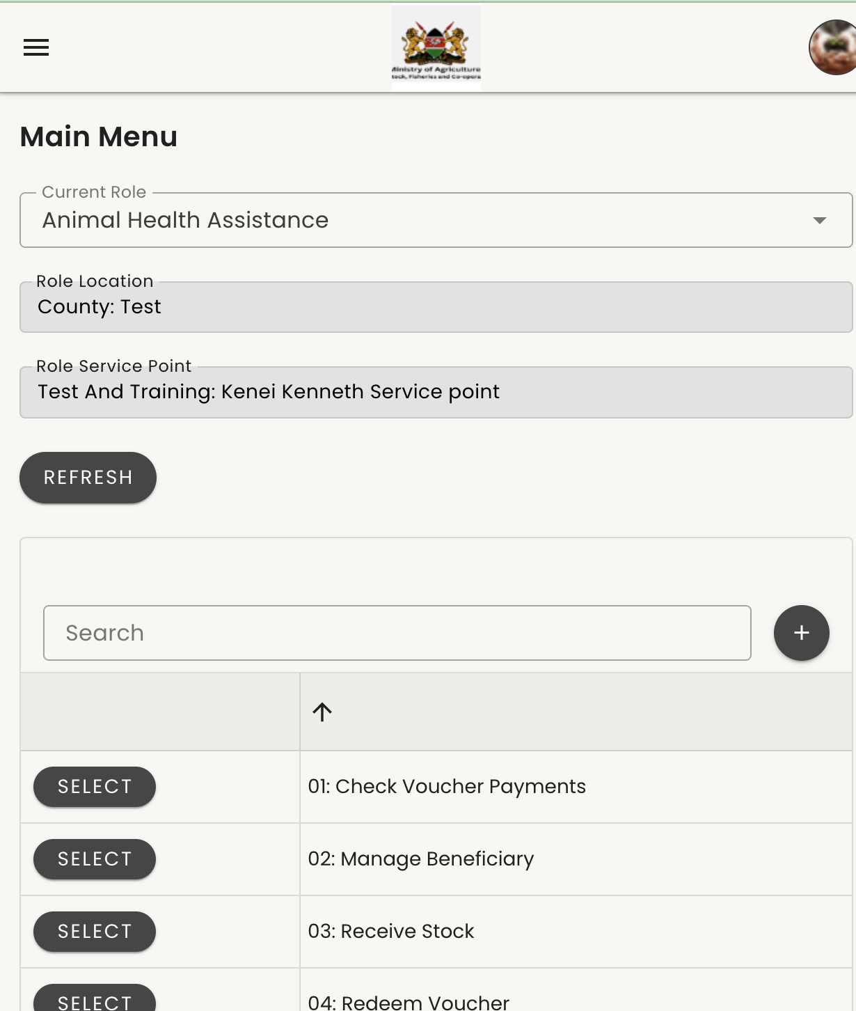
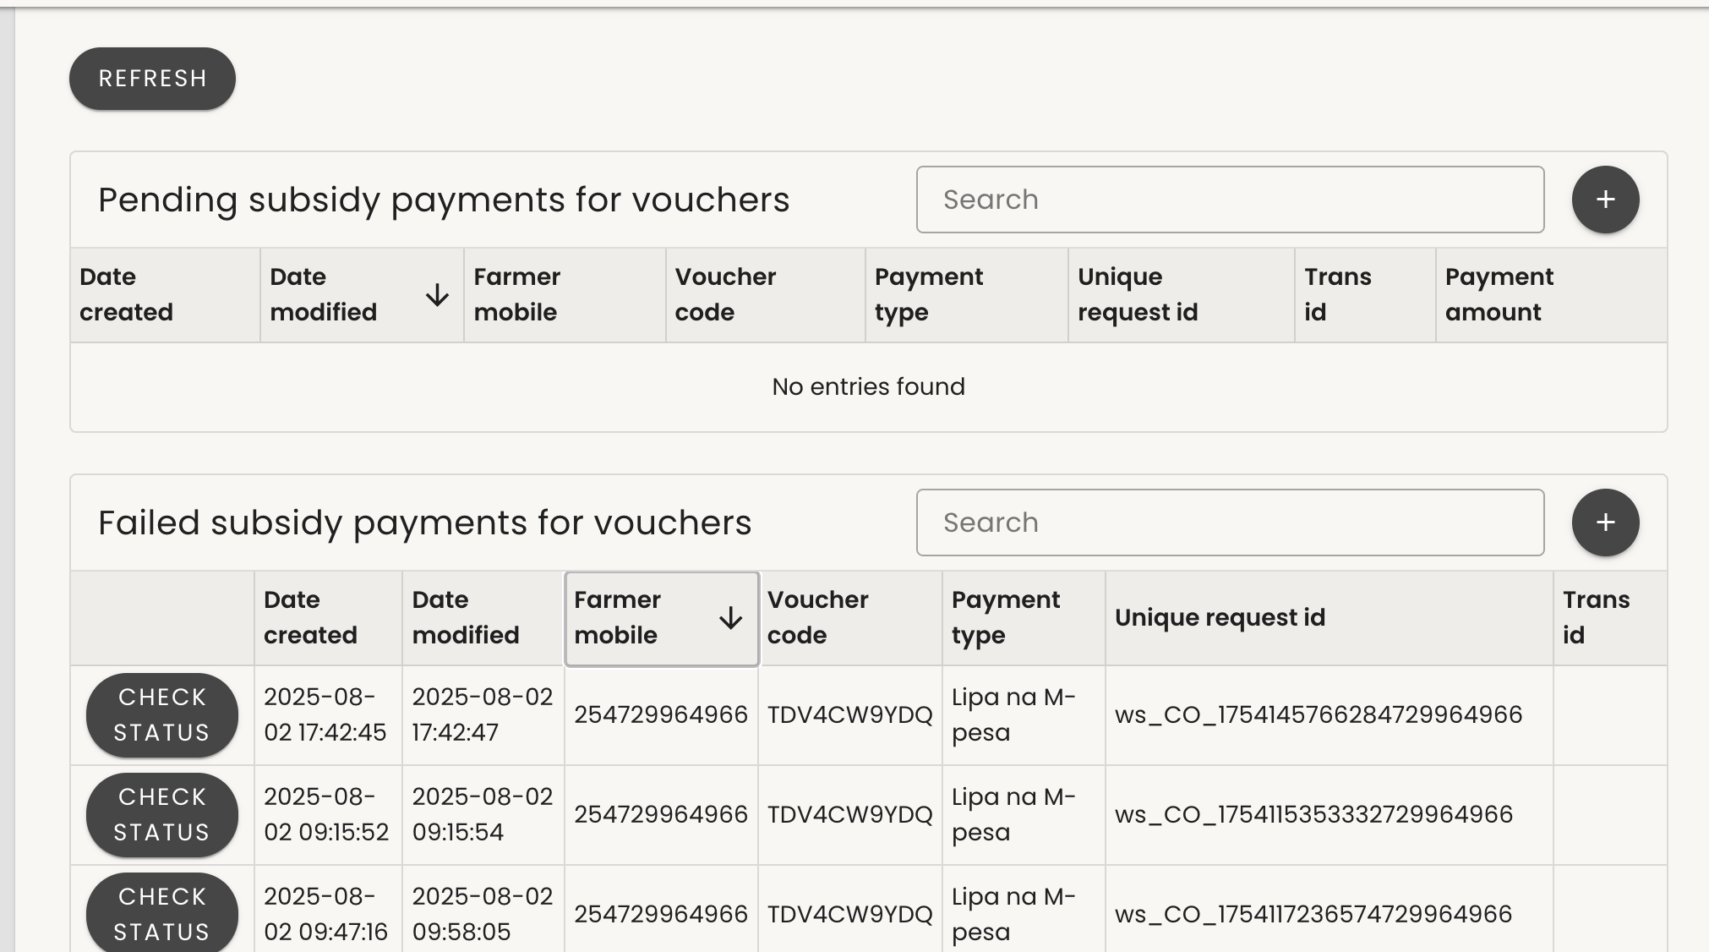
Check Voucher Payment
Check Voucher Payment
This is used when a farmer has paid and the amount has been deducted, but the voucher status remains “Not Redeemed.”
Figure 1
Log in as an AHS and click Check Voucher Payment.
Figure 2
A list of failed vouchers will be displayed. For the specific voucher, click Check Status. If the payment was successful, the system will complete the redemption and the record will move to the report.

Slide 32
Support Lines
Support Contacts
Email: easupport@mezzanineware.com
WhatsApp (Messages only): 254757980067 – Send the word “Hi” as the first standalone message. In a second message, describe your issue in detail.

